Slide 1
Saxotech training
For reporters

Slide 2
Saxotech basics
Web-based system
Cacheing stories/ photos
Saving
Searching
Categories, profiles and taxonomy

Slide 3
What you will be able to do after today
Sign in to Saxotech
Create a story, with the proper category, access control and publish time and date
Edit, preview, recache and find a story in Saxotech
Write a headline, net headline and SEO headline
Basic HTML
Extra fields: Fact boxes, email newsletter fields, source URL, video IDs
Add taxonomy properly
Linking

Slide 4
Sign in to Saxotech
The website:
http://edit.crainscleveland.com/red
User name and password:
If you don’t know what this is, talk with Nancy, Craig or Damon

Slide 5
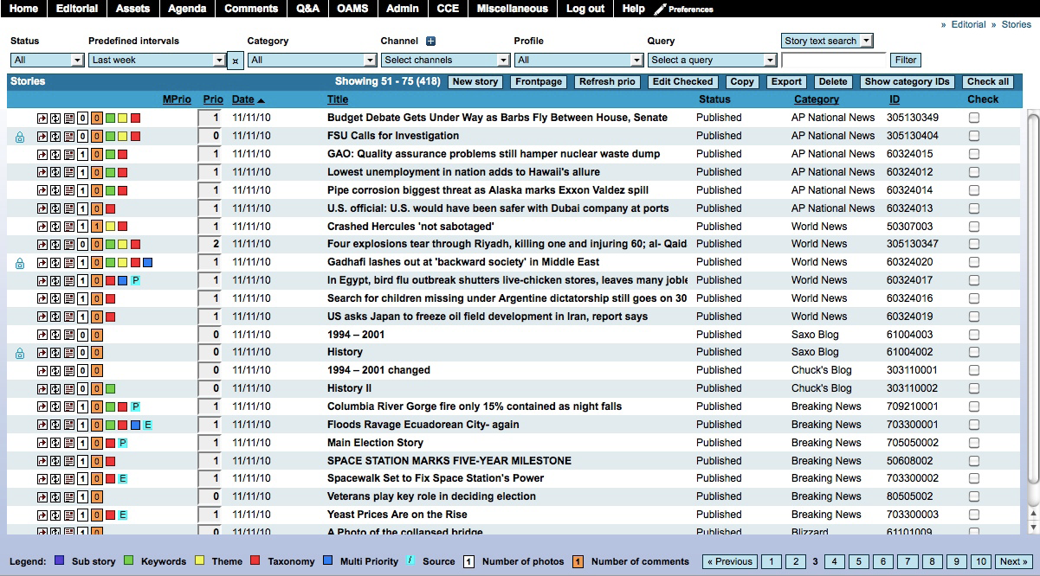
Navigating Saxotech

Slide 6
Changing your preferences
Edit story: Properties:
Use tomorrow’s date after:
23: 59
Default category (this is the category that will come up when you create a new story):
Crain’s Cleveland News for news stories
Blog for blogs
Default single sale: METERED
Edit story: General
* Enable draft on stories: Check, save draft interval in minutes – put 5 or 10 in this box
To change preferences, click on the preferences tab in the navigation

Slide 7
Searching / filtering for a story
You can search for a story several ways:
Status: Published, unpublished
Date: A range or exact date. Do not use ALL unless you have narrowed the search
Category: Narrows based on category, like News, AWARD40, etc.
Profile: This is how you sort for newsletters and to see how stories appear in a particular way

Slide 8
Saving and recaching stories
Stories and section fronts are built on the fly from the database. The information is not retrieved from the database every time a user requests a page. Instead, it is cached on the web server. This means that changes you make to stories might not appear immediately.
It is possible to force an update of the page if you need changes to appear immediately. You can force the update of stories and section fronts with stories from the story list. Section fronts without stories have to be rebuilt from the categories page.
Editor’s sidebar: Find it here --- https://cis.zendesk.com/hc/en-us/articles/200314916-Editor-Sidebar

Slide 9
To create a new story
On the main CMS page, click on either “Editorial” in the navigation, or on “New story” in your shortcuts

Slide 10
Properties tab
Select main properties for the story:
Category
Access control (metered)
Published or unpublished
Publish control
Teaser

Slide 11
LEAVE unpubished while working on story
Publish time and date, click USE PUBLISH CONTROL
Category: News for regular story; blog category for blog
Access control: metered
Teaser checked for home page or other special uses
Kicker for kicker field in newsletters, section pages

Slide 12
Edit window
Kicker: Used for sources, overlines
Title: This field shows the main story headline.
Subtitle: Support for the title
Net title: A web title – used for when there is a print title pulled in from the issue.
Summary: Always include a summary – 20 to 40 words are optimal. Appears on section pages, in the home page well.
Byline: (Smartbyline dropbown); add for blogs, too. It allows us to aggregate stats for all your stories

Slide 13
Story body
Paragraphs
Subheads – these break up content and make it easier for readers to scan
WYSIWYG (What you see is what you get)
HTML
Insert paragraphs
NOTE: Avoid all-caps in headlines and stories. All caps may look great in print, but online it is hard to read and best avoided.

Slide 14
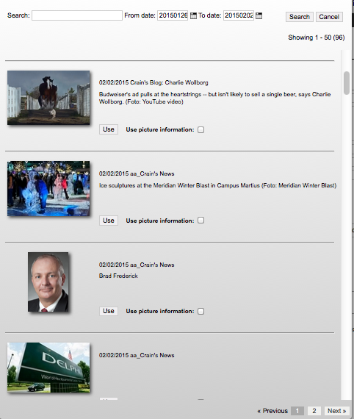
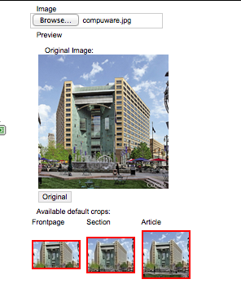
Photos
Search or browse for image
Caption: Always include one. Always.
Photo credit: Always include one. Always.
ALT text:
Filename (SEO)
Image sizes – always make head shots 400 pixels wide by 600 pixels deep whenever possible; horizontal main images should be at least 880 pixels wide and vertical should be at least 440 pixels wide

Slide 16
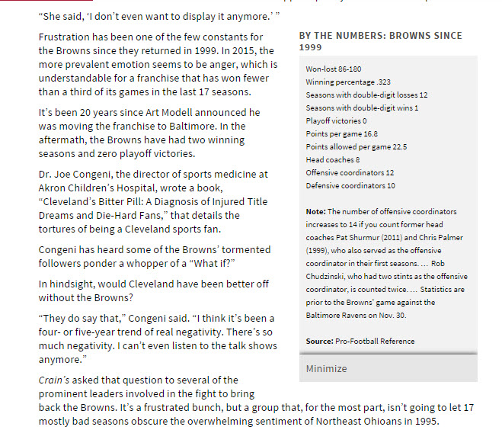
Fact box
Think “chunks” of information:
Bullets or bold – you don’t usually need both
Spacing
Can include links and other HTML, google maps

Slide 17
Taxonomy
Search
Choose from list
Auto scan
Add taxonomy for Industry/Topic; People or Companies; General; Geography

Slide 18
Taxonomy vs. Profiles
Here’s what happens when you click on one:
Here’s how they look at top of a story.

Slide 19
Connections
Internal links (stories, photo galleries)
External links
Assets (PDFs, external photos)

Slide 20
Photo galleries
To create a new gallery, go to NEW GALLERY out of the EDITORIAL tab.
To edit a gallery, go to GALLERIES to find ones done already.

Slide 21
Galleries
Unpublish til its ready to go
Add a description that will appear on the standalone gallery page
Add taxonomy as you do to a story

Slide 22
Add images
Best to add images one by one, not batch
If there is IPTC information on images, you can pull it in automatically here by clicking the bottom three checkboxes
The byline will be picked up in subsequent photos. Just don’t close this window before you are done
Move images around or delete them where necessary BEFORE you save.
Be sure to SAVE at the top when you are done

Slide 23
Add new images here
Open image to edit it
Delete image here

Slide 24
Add gallery to story in internal links (from Connections)
* Search for gallery by changing type to PHOTO GALLERY, changing search interval, using text search box, or narrowing by profile or category

Slide 25
Once you find your gallery, click box and apply connections

