Slide 1
Engaging with Your Audience
Tactics to use across all platforms

Slide 2
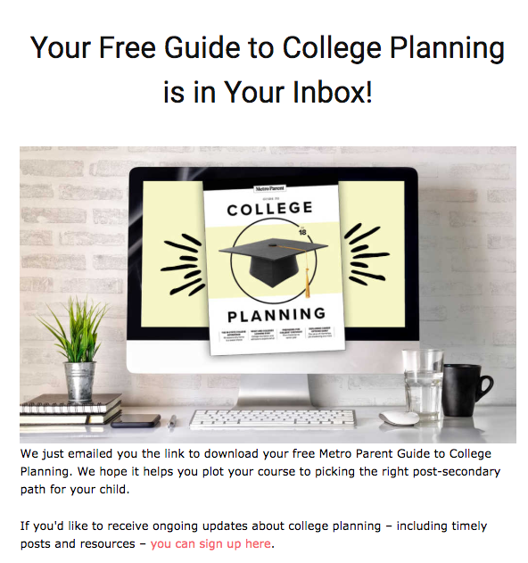
AUDIENCE ENGAGEMENT
Getting people in the funnel is great, but how do we keep them ENGAGED?
Welcome Journey
Engagement Funnel
Interest Tagging & Segmentation
Reader Surveys
Post Event Emails
New product funnels

Slide 3
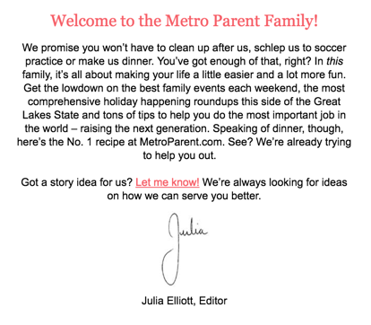
Welcome Journeys
Welcome journeys are your way of rolling out the red carpet for your new email subscriber and learning as much about them as you can early on in the relationship.

Slide 4
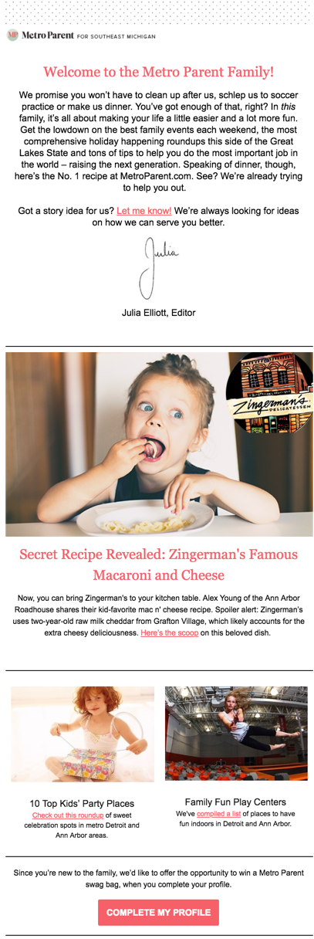
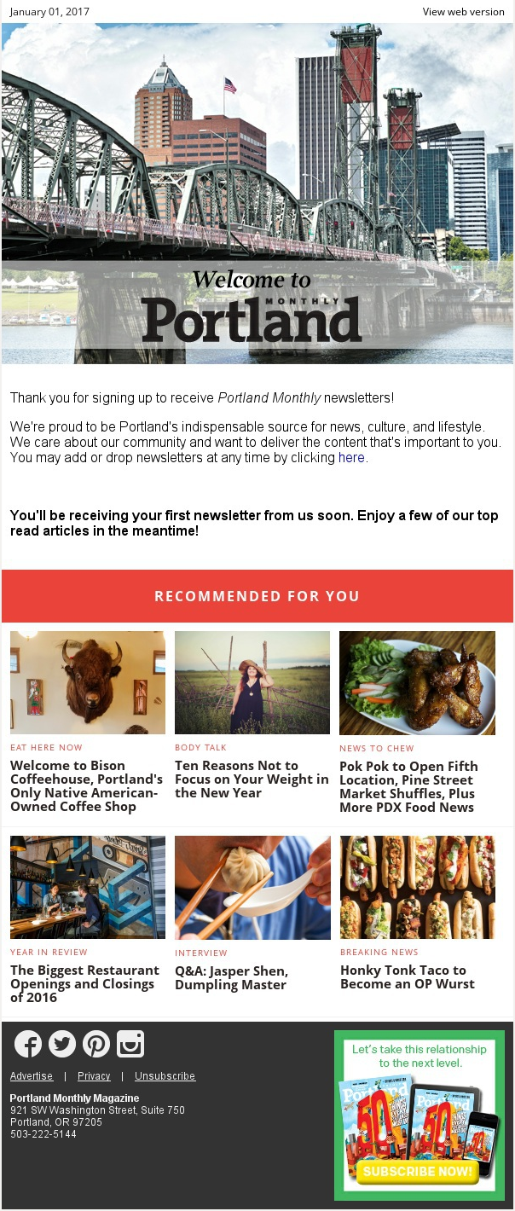
Welcome Journeys

Slide 5
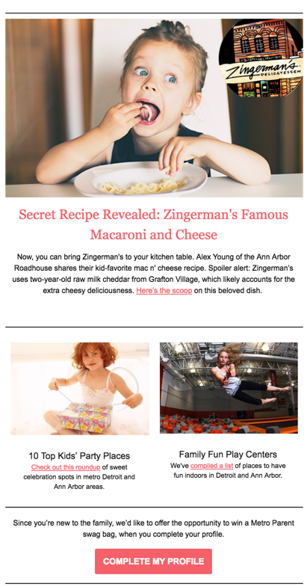
Metro Parent Welcome series
Welcoming readers to the family by introducing them to all we offer.
FOUR EMAILS, spaced a week apart, sent to anyone who “joins” the Metro Parent family.
Begin “interest tagging.”
Email 1:
39% overall open rate
14.8% click-to-open rate
Interest tag:
FOOD

Slide 6
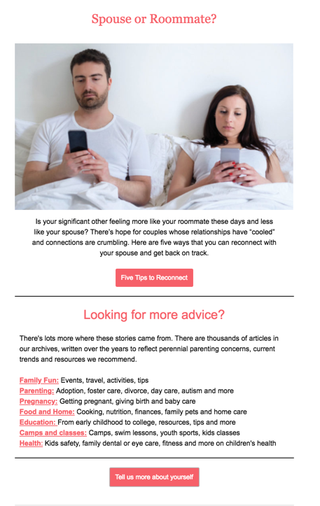
Email 2: Content
One week after Email 1
Introduce some of our most engaging stories and content
Email 2:
Open rate: 22.1%
Click-to-open rate: 10.7%

Slide 7
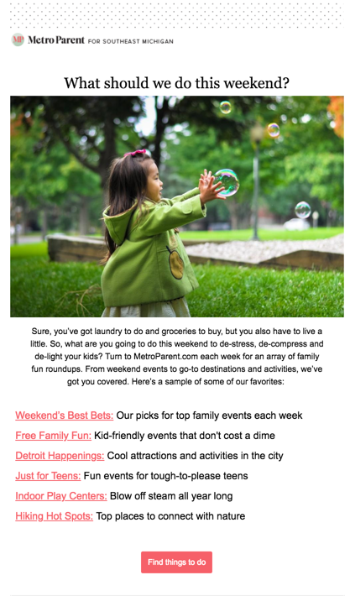
Email 3: Things to do
One week after email 2
One of the biggest draws to the website is events and things to do with the family.
We add interest tagging to identify readers interested in activities
* 2617 contacts now have tag: INTEREST-Activities
Interest tag:
ACTIVITIES
on link click
Email 3:
Open rate: 22.9%
Click-to-open rate: 35%

Slide 8
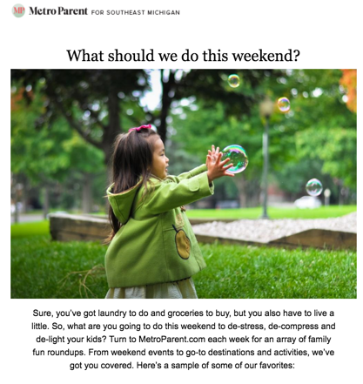
Use interest tagging to segment
New automation:
“Looking for things to do with the family this summer? Check out our Fun Guide, with hundreds of destinations and activities ….”

Slide 9
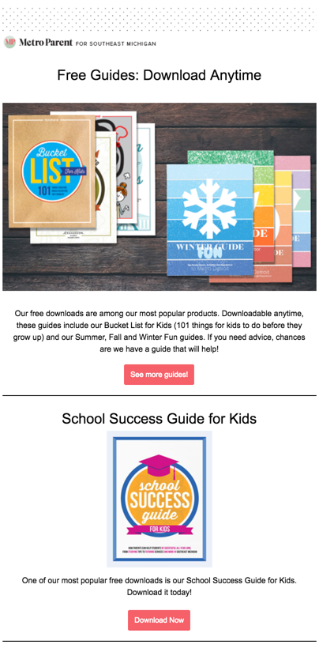
Email 4: Freebie downloads
Sent one week after Email 3
Showcases downloads – encourages lead-generation
Email 4:
23% open rate
14.7% click-to-open rate
Interest tag:
EDUCATION

Slide 10
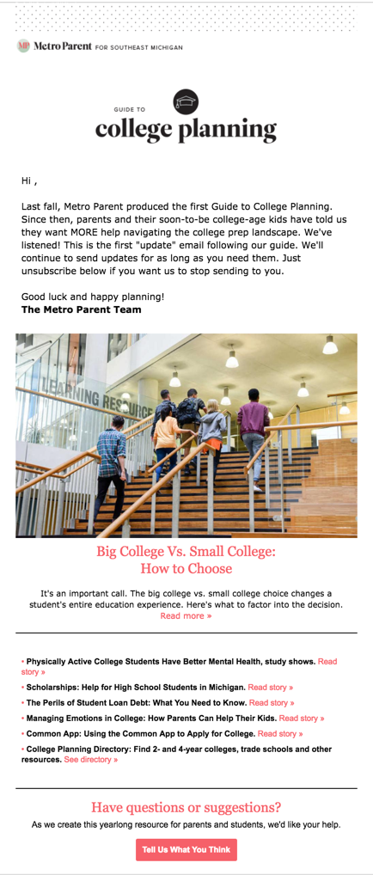
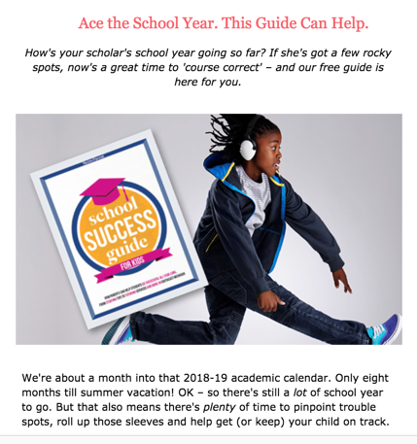
Interest tagging to segment

Slide 11
Overall results: Welcome Journey
Freebie downloads
Email readers
Contest entrants
Newly engaged, more informed
After 3 months:
4,006 contacts entered
1,520 opens
272 clicks on stories

Slide 12
Best practices for Welcome Journey
* Introduce different types of content * Show off offerings (events, products, top content, downloads)
* Suppress from dedicated advertising emails
* Watch results and refresh 3-4 times a year

Slide 13
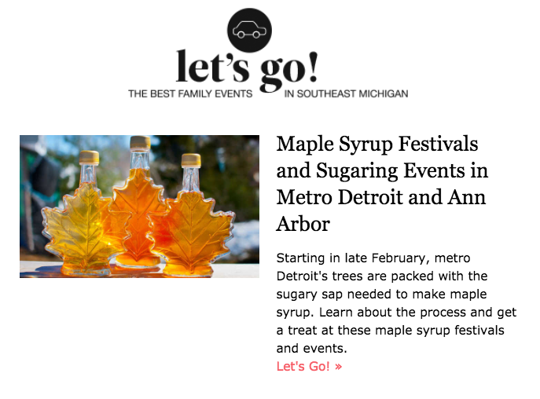
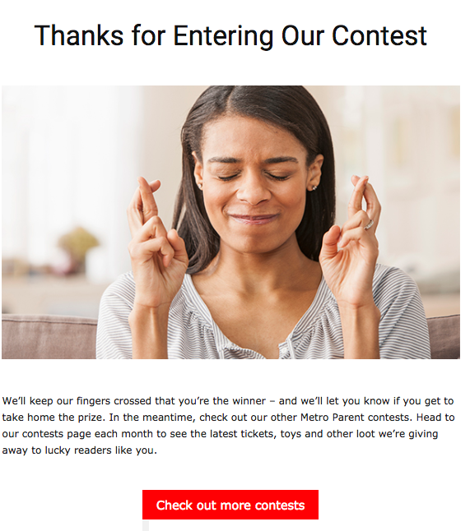
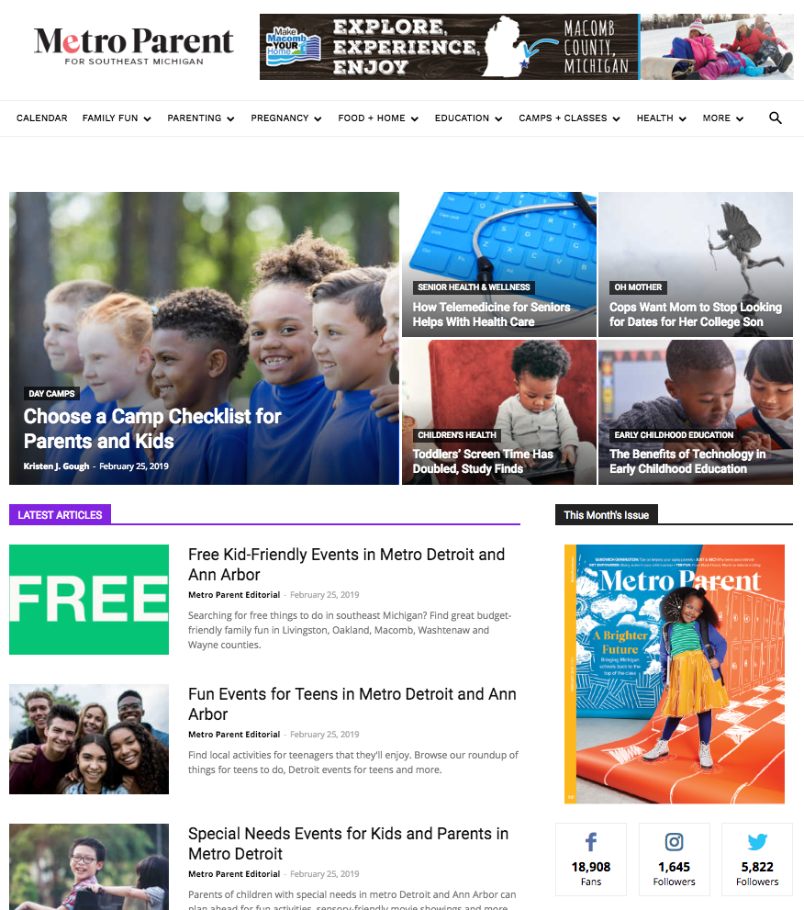
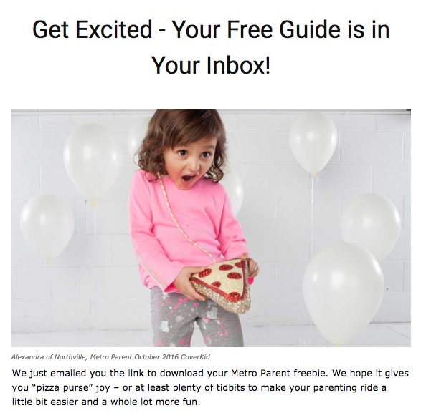
Create triggers for engagement
Enter … Click … Download … Open … Submit

Slide 14
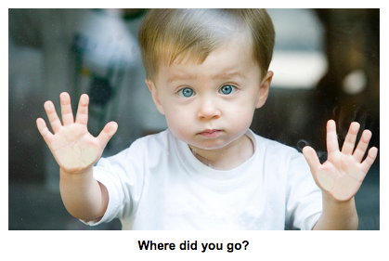
Re-engagement Campaigns
* Last chance to “re-engage” with those who’ve stopped responding or engaging
* Culls lists in a smart, methodical way
* Keeps your brand on the radar long enough to reconnect

Slide 15
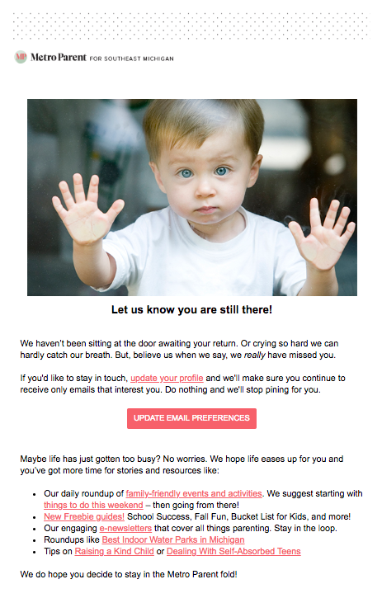
Re-engagement email
10.8% open rate on first send to 19,000 unengaged
After initial campaign:
Use on people who “disengage” for a significant amount of time (6 MONTHS)
Biggest engagement link: 187 clicks to update email preferences

Slide 16
Creating a re-engagement funnel
Contact enters
Tag: ENGAGED
Start: 6-month engagement funnel
Any action (open, click, submit) =
Re-enter funnel
If someone gets to END of 6 months, tag INACTIVE
INACTIVE tag triggers
RE-ENGAGEMENT EMAILS

Slide 17
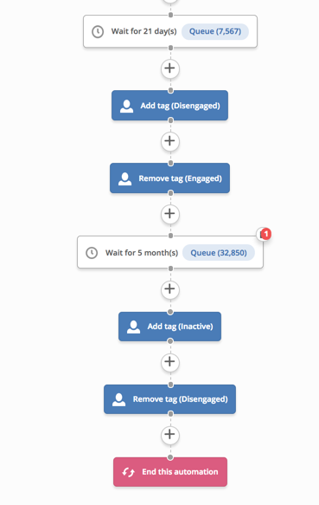
The engagement funnel
EVERYONE is in this funnel all the time until they are INACTIVE

Slide 18
Tag=Inactive Re-engagement journey
Email 1: After 6 months of inactivity
Email 2: 7 days after first email, if no action
Email 3: 7 days after second email, if no action

Slide 19
We get the hint …
After three attempts at re-engagement, confirm the contact is “unengaged” and unsubscribe them from all lists
…but the contact remains in the system, with all audience information attached

Slide 20
Best practices
* Respect your audience’s preferences
* Stop sending to disengaged emails
* Automate!
* If done properly, this should boost both engagement AND email performance

Slide 21
Interest tags
Holidays
College
Activities
Food
Camps-Classes
Pregnancy-Babies
Education

Slide 22
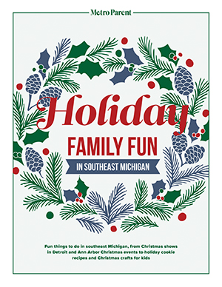
Interest tagging and segmentation
* Add tags that will help you identify strong audiences
* Tag content you know you can connect to future efforts
* Use all areas of business: Events, website activity, social media interaction

Slide 23
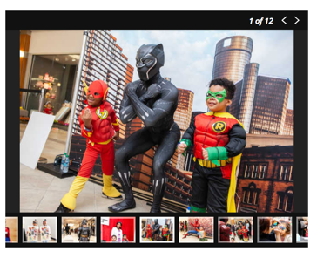
The audience funnel for events
Opportunities and ideas for taking audiences before, during and after an event and engaging them:
Social media before, during and after
Postevent surveys using Google Forms or Survey Monkey
Pre- and postevent emails to engage attendees in content on site and take surveys
Postevent galleries and videos

Slide 24
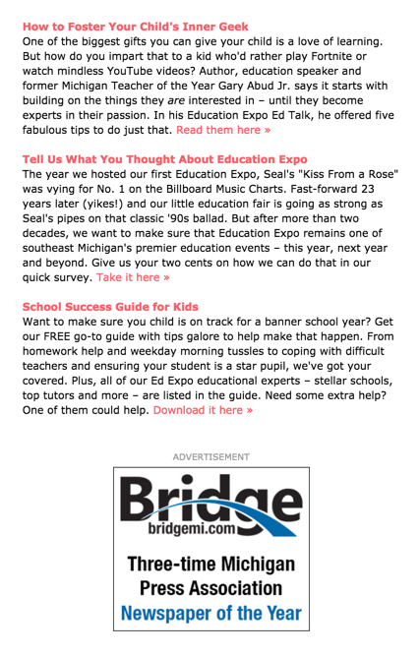
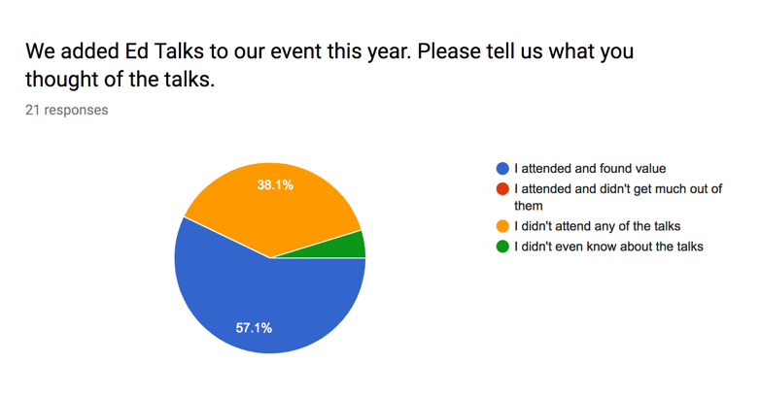
Audience and events: Education Expo
Post event email series (4 emails) revisited content and gave sponsors a boost
Gave attendees a chance to provide feedback

Slide 25
Results: EdExpo postevent emails
4 emails sent in post event promotion
33.45% Overall open rate for series
9.97% click through rate

Slide 26
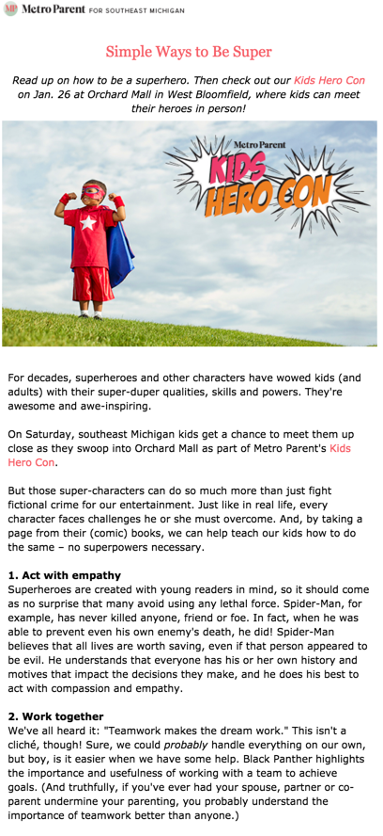
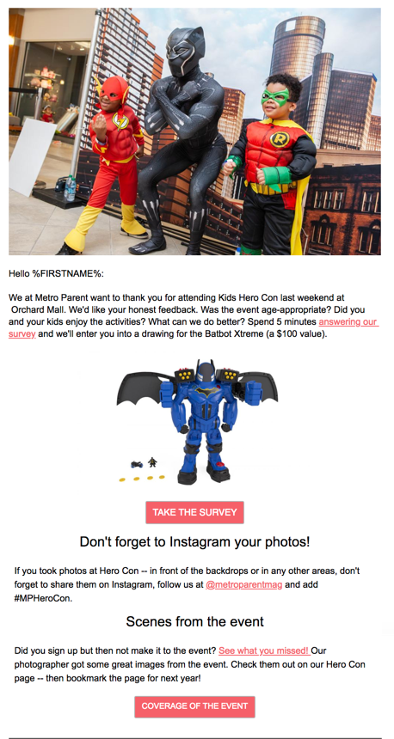
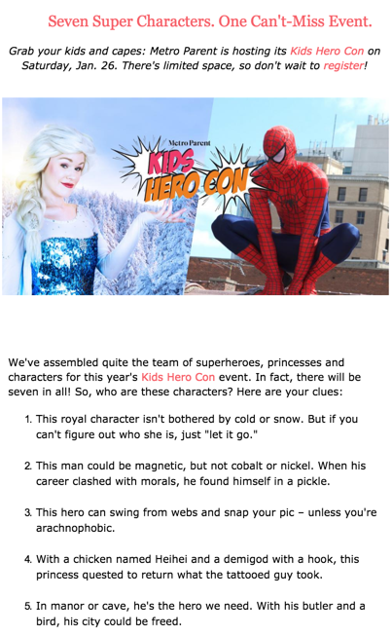
Kids Hero Con

Slide 27
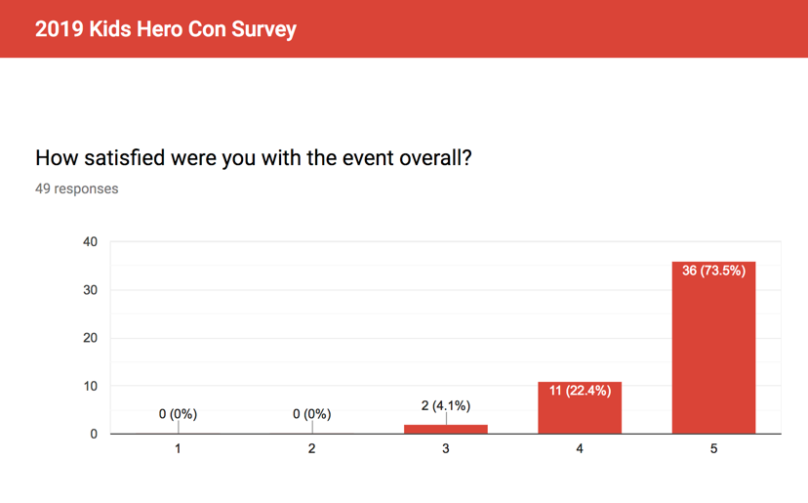
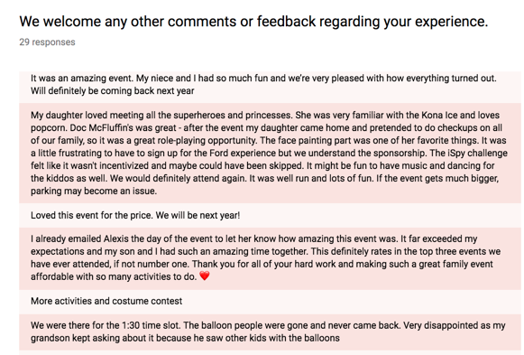
Events and audience
* Integrate content into invitations
* Use interest tagging to identify event attendees
* Use survey results and feedback to plan for next year
* Use all possible platforms and tactics

Slide 28
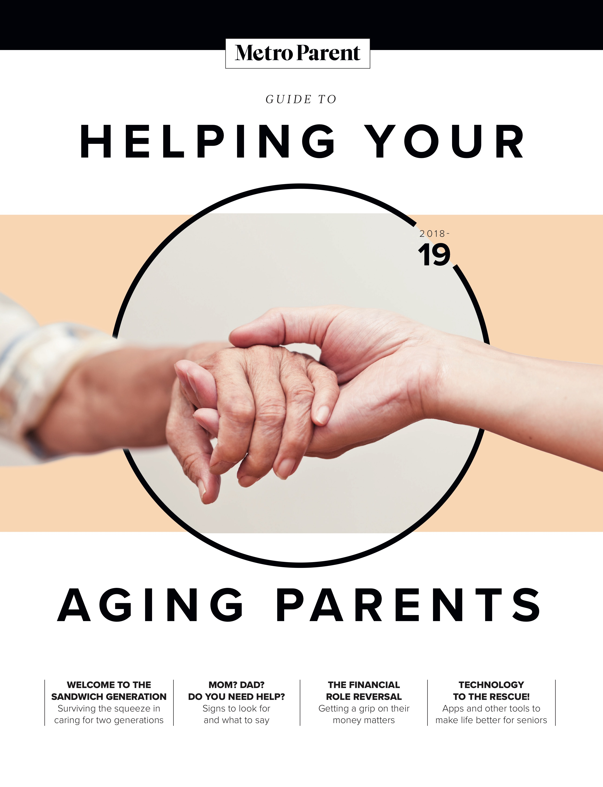
New publications: Audience opportunities
- Creating interest-based funnels
- Opt-ins for emails
- Using analytics to tell a story to advertisers
- Using SEO analysis to elevate content

Slide 29
College Planner: New publication
- A segment of parenting audience we want to develop
- Reached out to high school counseling offices for distribution
- Separated journey from other “freebie” downloads
- Asked readers if they wanted to be added to a list for future updates

Slide 30
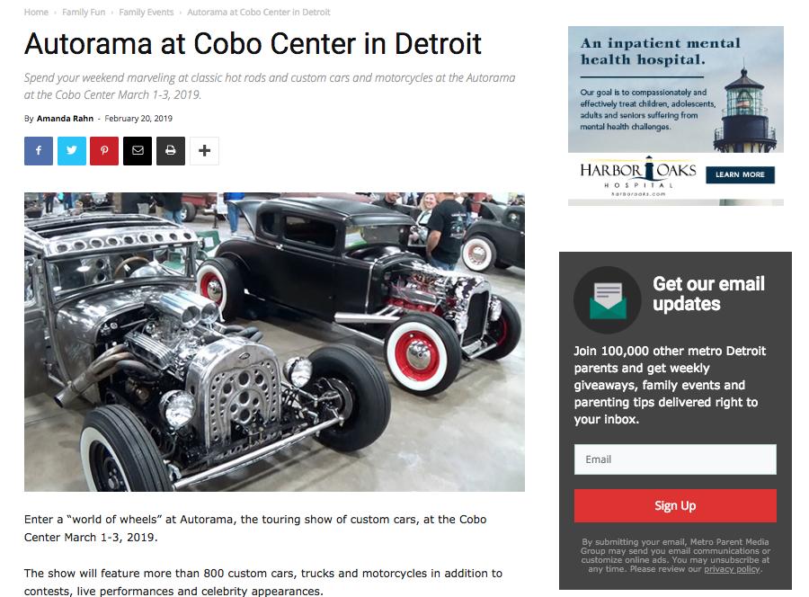
Differentiation
Instead of regular email signup box that is throughout site, we added a signup box for college planning updates

Slide 31
Outreach to high school counselors
64.2% total open rate!
Several counselors reached out with offers to distribute

Slide 32
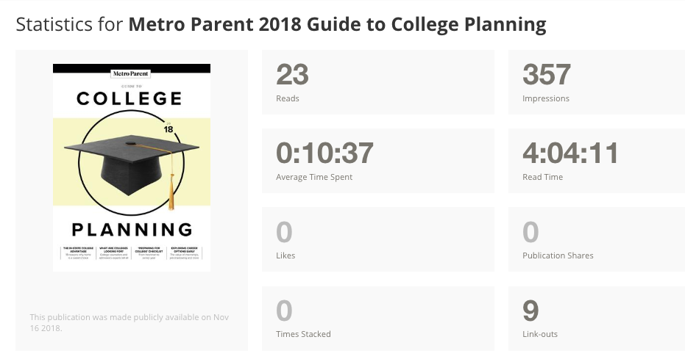
Added flipbook version of planner

Slide 33
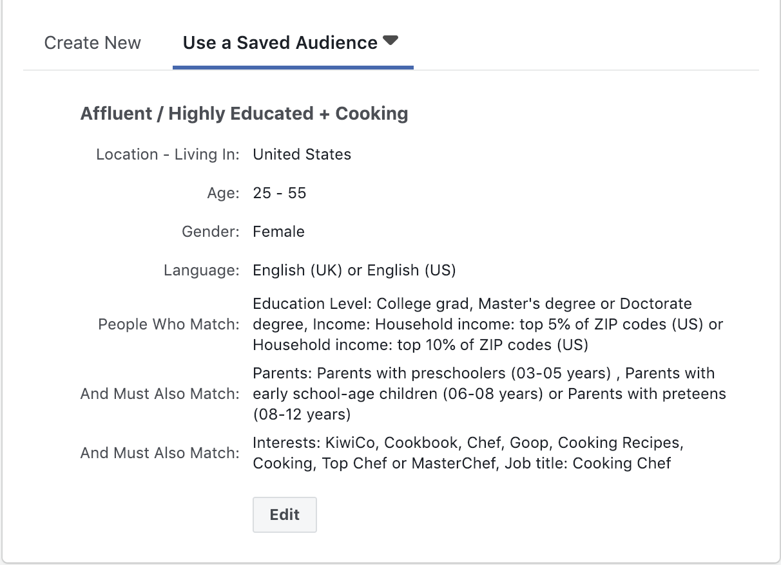
Smart Social Media Strategies
* When targeting new audiences, start broad but still target your ideal audience.
* Test, test, and test again.

Slide 34
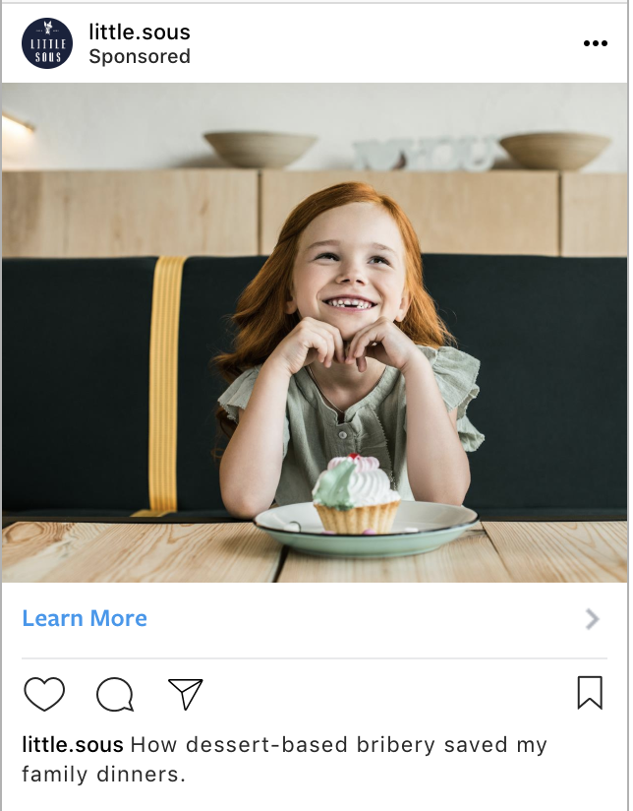
Smart Social Media Strategies
Use social media to strategically develop the relationship.
Target engaged users in your welcome workflow.
Tap your existing newsletter lists first when selling event tickets, products, and subscriptions

Slide 35
Facebook Lead Ads
Use these to get people in the funnel
Tie them directly into CRM via Zapier
Create engaging form – quick survey on something fun

Slide 36
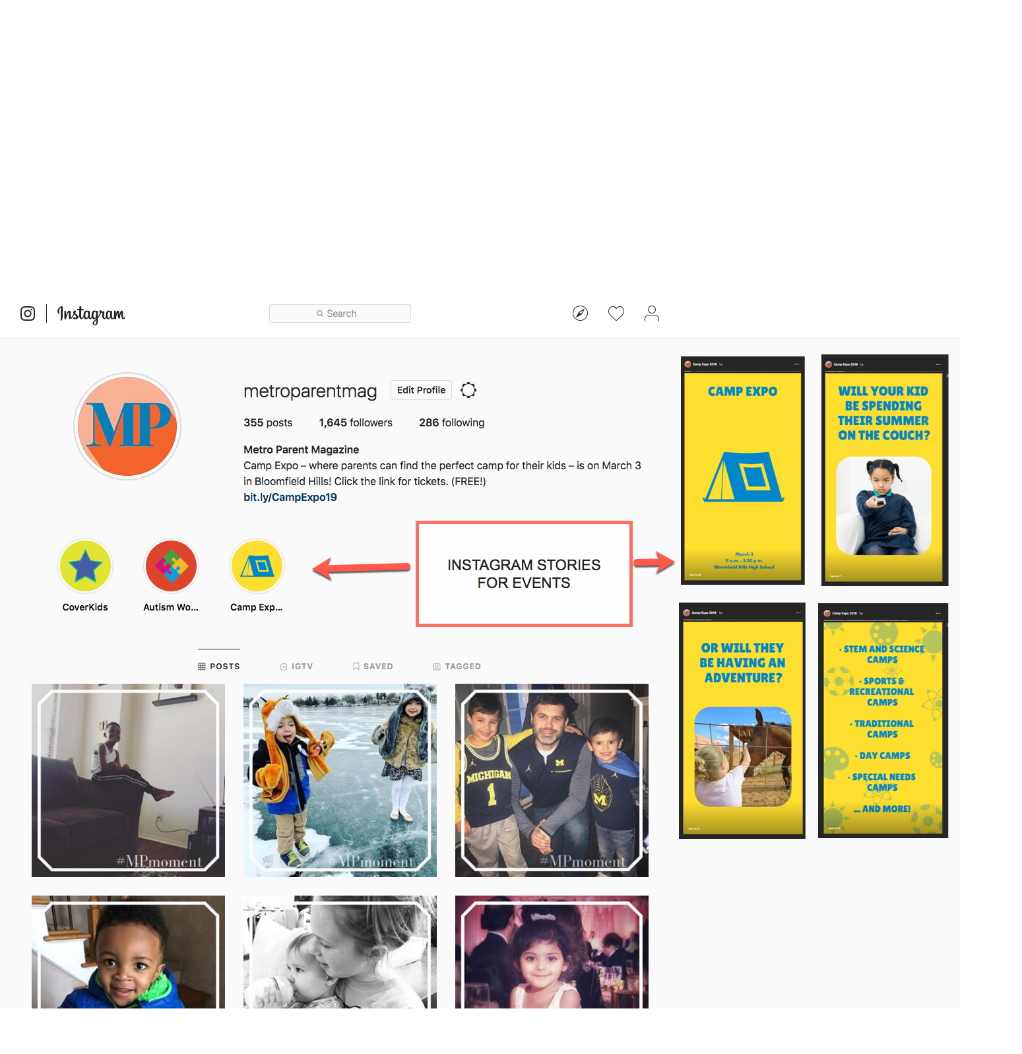
Instagram for events: Before, during, after

Slide 37
Pinterest: Opportunity to expand reach
270,000 average monthly visitors – many from outside Michigan
Second largest referrer of social traffic after Facebook
Can you use it to MONETIZE?
Can you use it to EXPAND products beyond local?

Slide 38
Lessons and takeaways
Segment. One size does not fit all.
Monitor. Pay attention to what your audience is doing.
Recalibrate. Assess, review and update to fit changing preferences.
Be strategic. Online, in social and in email.

