Slide 1
Data: the holy Grail
How to take advantage of our platforms

Slide 2
4 COMPANIES and data integration
Business News/BNiQ, Western Australia: Charlie Gunningham, CEO, says the data approach to subscriptions and content is “the reason we are still around today.”
Crain Communications: Its 20 business publications for nearly 100 years operated very independently – but in the past two years began “integrating” platforms to build on audience and data across the company.
New England Business Media (Mary Rogers, COO): Spent much of the past year coming up with a plan for one integrated platform for Research/Listings, Event Ticketing, Enews, Website Hosting and Print Subscriptions.
Arkansas Business (Jake Sligh): Bolt-on approach, using Adestra to build a unique identifier for customers based on email addresses.

Slide 3
BN / BNIQ WESTERN AUSTRALIA
Charlie Gunningham, CEO
Dotcom owner (2000-2010) to Business News CEO
Built and leveraged BNiQ, a data product, to build a strong digital audience
HERE’S HOW HE DID IT …

Slide 4
Crain’S journey: MANY BRANDS, TOO MANY Platforms

Slide 5
The CRAINSCAPE 3 YEARS AGO More than 20 independently run publications using a combined 140+ vendors

Slide 6
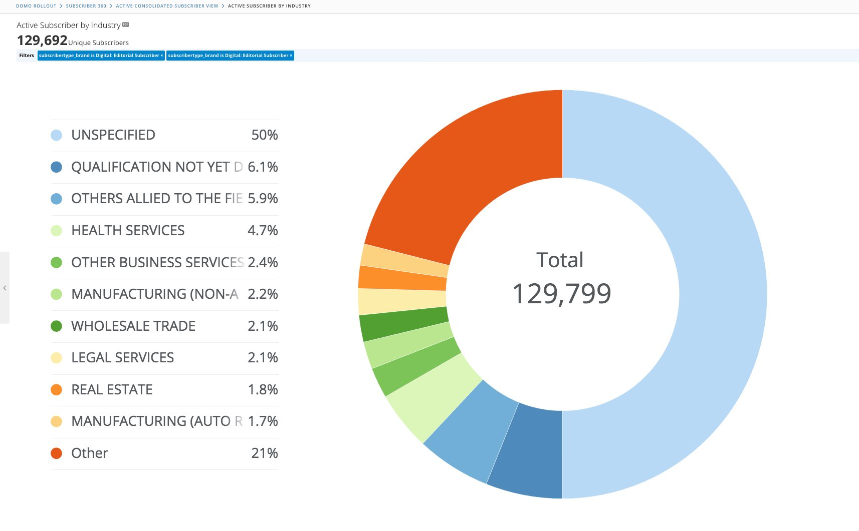
CRAIN: a journey with data
SalesForce Marketing Cloud: Create one customer identification piece
Content Station and Drupal: Replace front end and CMS
Bolt-on platforms and systems like Pardot, Engage, Cvent
Begin pulling in analytics from all of it into dashboard using DOMO

Slide 7
DATA INTEGRATION: the hard part
Audience data: Registered users and subscribers
Customer identification platform that ties everything else together
=
Email newsletters and marketing

Slide 8
CLEANING UP THE DATA
Employ data governance
Consider brand needs
Engage consultants
Conservative approach
Are we matching them tightly enough?
ONGOING CHALLENGE!!!

Slide 9
DATA: HOW TO HARNESS IT
Analytics for action
Bolt-on platforms & tools
Salesforce, Pardot, Engage: Advertiser & marketing data and tools
Advantage: Print subscribers
Clickshare: Digital & transactional
Cvents: Event attendees

Slide 10
ANALYZING THE DATA: DOMO

Slide 11
Domo: 360 view of customer

Slide 12
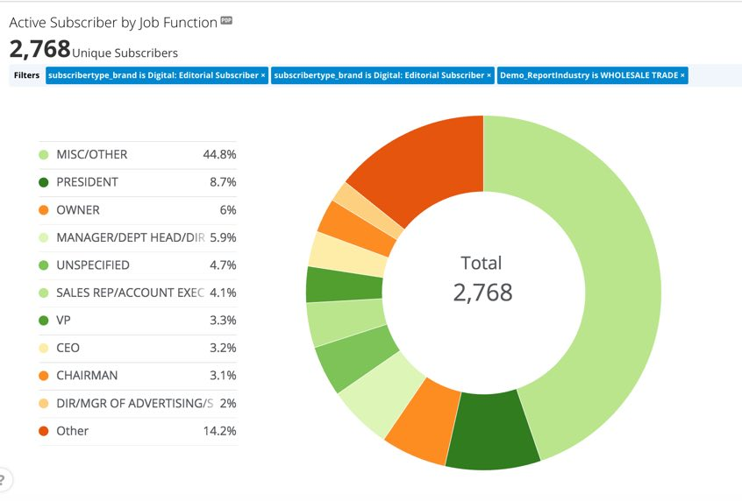
Domo: ties back to salesforce id

Slide 13
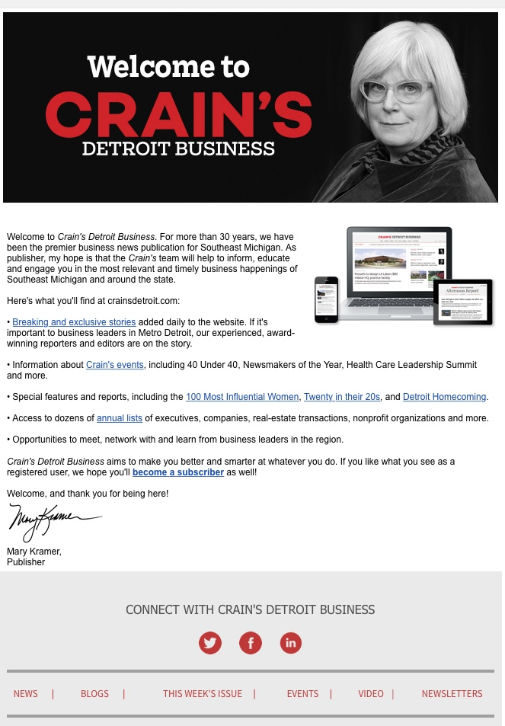
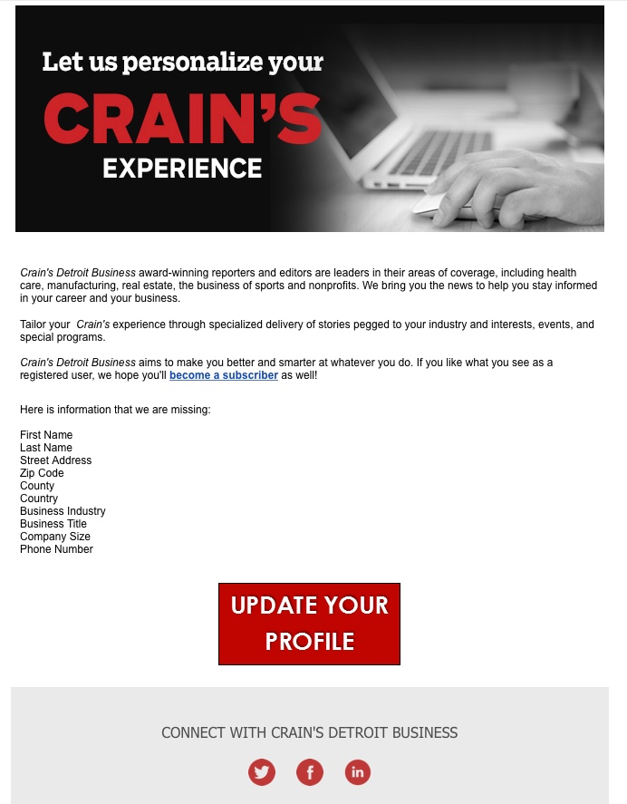
LEVERAGING THE DATA
Email journeys
Segmenting audiences
Online messaging based on segmentation

Slide 14
Content management upgrade

Slide 15
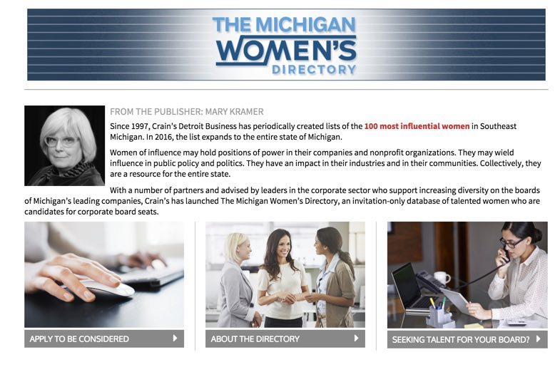
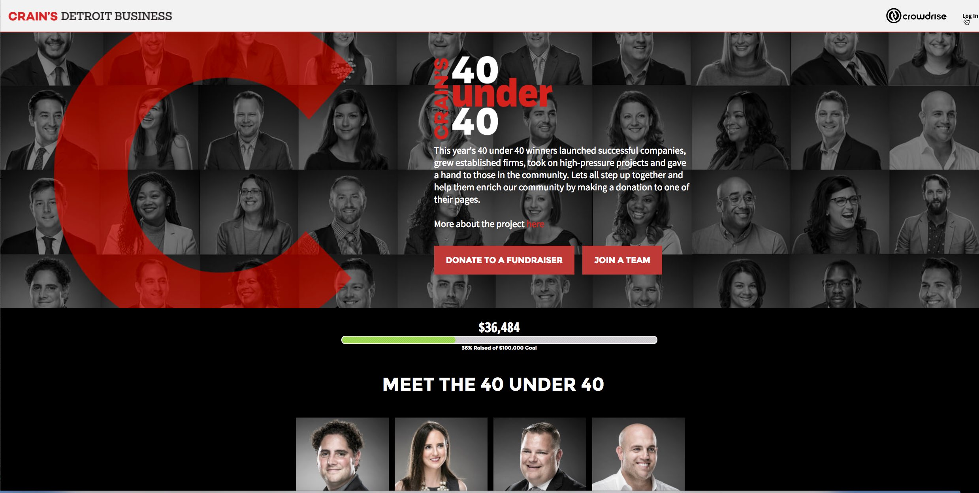
Tying it back to content, engagement
Content and expertise: What we have that readers want
Engaging them at a higher level

Slide 16
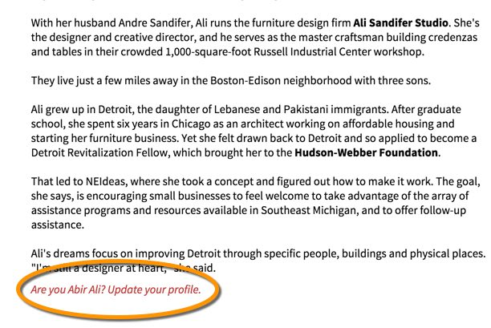
40 under 40 – 25 YEARS: gateway to people database
40s profiles: Updating the database

Slide 17
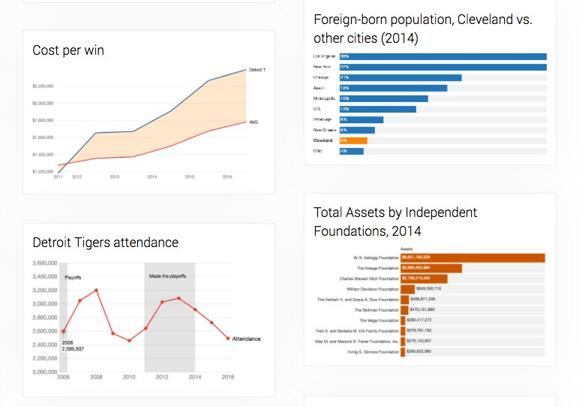
Data, data, data
Data memberships
All lists will go behind a paywall – no more one-off sales
Surveys will be updated dynamically through forms on the site
Data will be used throughout the site to “sell” what’s underneath

Slide 18
Bringing IT all together
AUDIENCES
ANALYTICS
SUBSCRIBERS
WEBSITE
REGISTERED USERS
AUDIENCE
EMAIL SUBSCRIBERS
SOCIAL MEDIA
ADVERTISING
SOCIAL MEDIA FOLLOWERS
MULTIMEDIA
DATA SALES
EVENT ATTENDEES

Slide 19
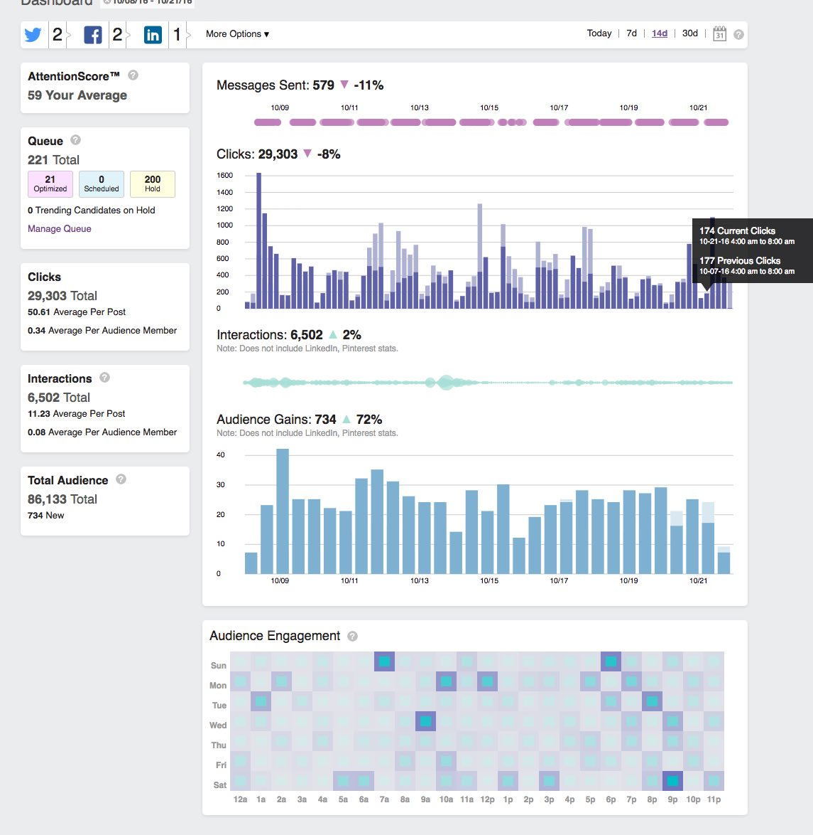
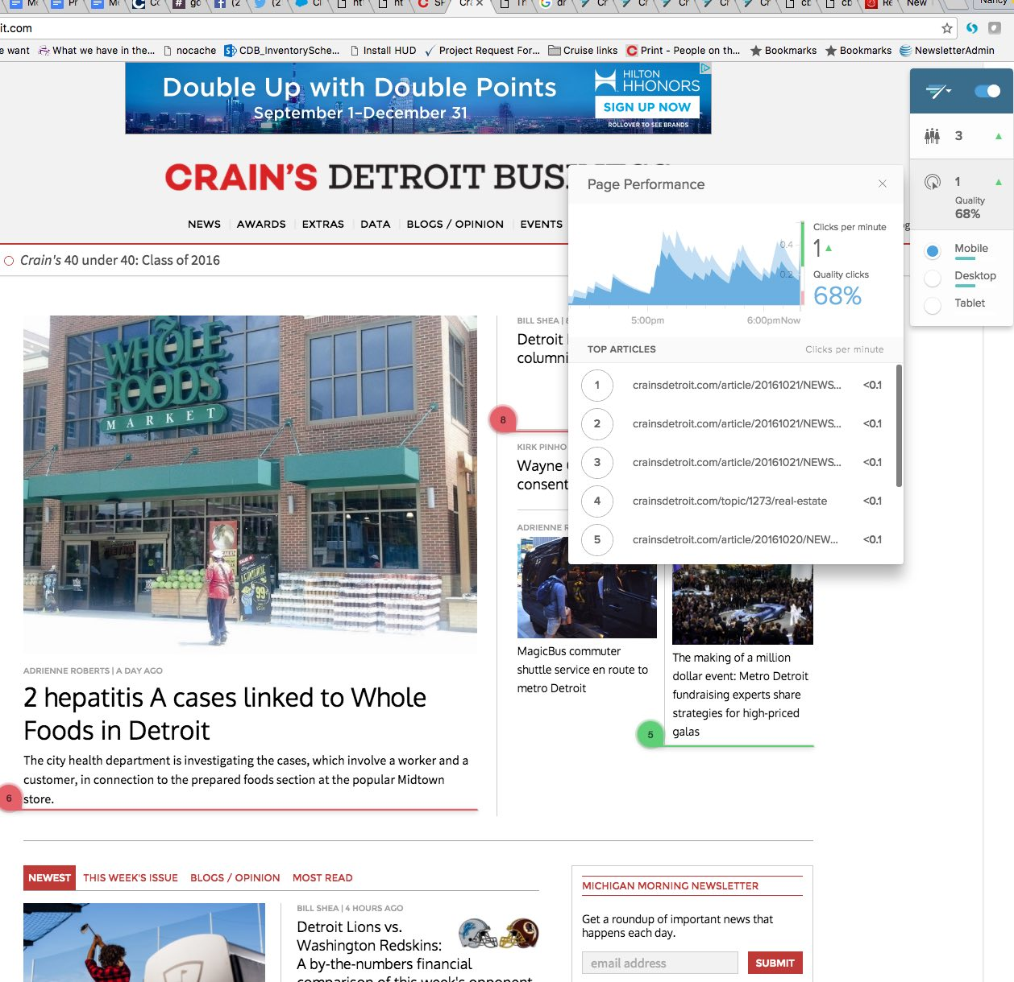
WHAT YOU CAN DO
Analytics tools: Social flow, Adobe, Chartbeat

Slide 20
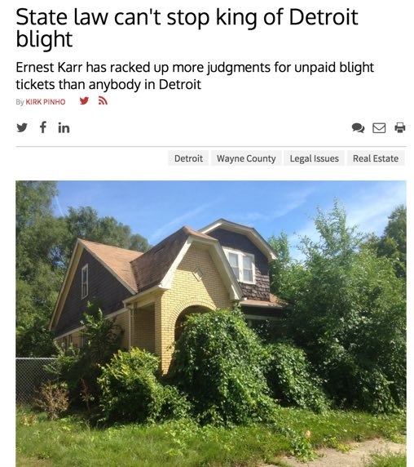
Cool data tools: SHOW OFF what you have!

Slide 21
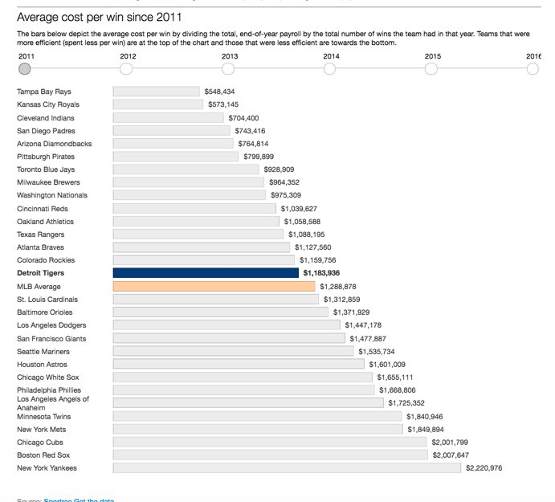
OTHER TOOLS
Carto: Interactive maps
Caspio: Searchable databases
Datawrapper: Simple charts and grafs
Highcharts: Responsive charts and grafs
Google maps: Easily embeddable maps
Tableizer: easy to convert spreadsheets to online charts

Slide 22
Email journeys
Emails at regular intervals to segments of the audience
Registrant welcome journeys
Cart abandonment
Re-engagement journeys
Paywall journeys
Event- and action specific journeys

Slide 23
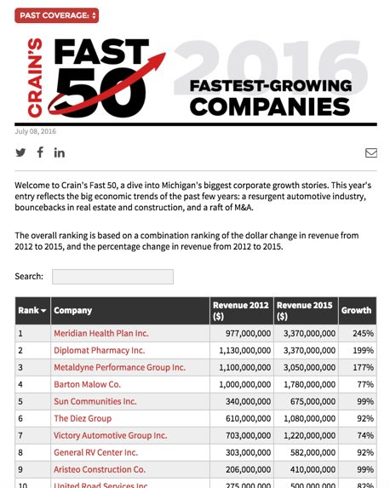
Relate your data

Slide 24
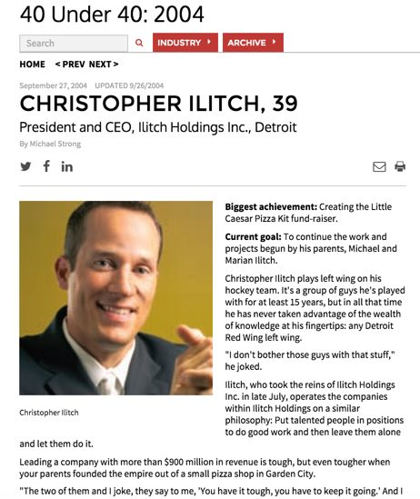
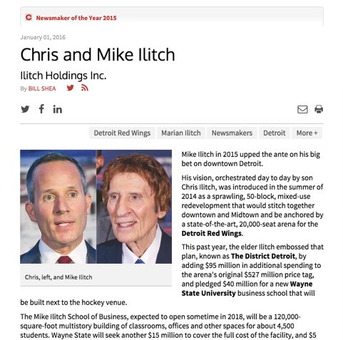
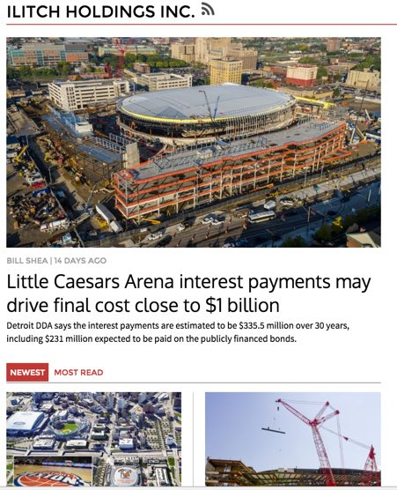
Chris ilitch

Slide 25
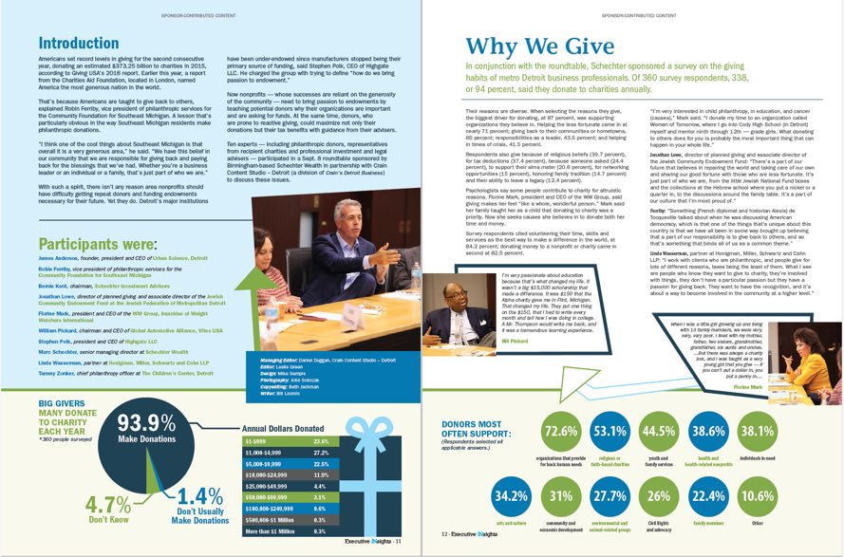
LEVERage your expertise AND AUDIENCE: custom

Slide 26
Similar goals, other approacheS
Mary Rogers: New England Business
Jake Sligh: Arkansas Business

