Slide 1
Helping Your Aging Parents
Metro Parent’s Guide to
Half-year Status report

Slide 2
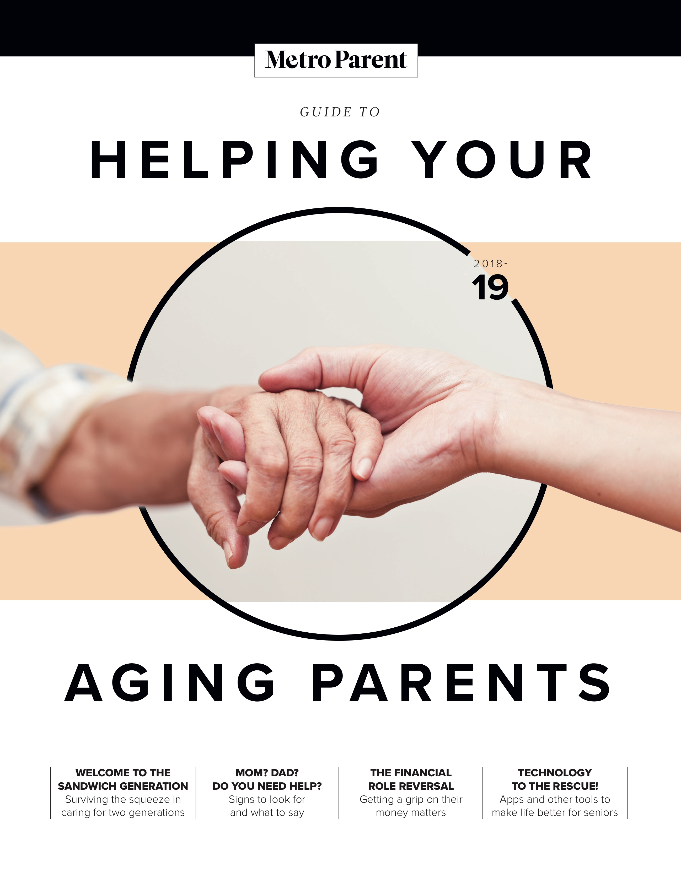
Summary: December 2018-April 2019
The first Guide to Helping Your Aging Parents was published
in November 2018.
Print readers: 50,000 *
Digital: 6,000+ page views in first 5 months, average time on page of 2:05. That’s 208 hours total spent.
Downloads: 305 reads in PDF and flipbook format
Facebook: 25,633 reach on 29 posts
Ad impressions delivered: 200,000+ in first 5 months.
81,907 is the total audience so far **
* 20,000 copies x 2.5 readers/copy
** Expected total audience, 12 months: 150,000 – includes print, digital, downloads and social reach

Slide 3
A guide that fills a need
Nearly half of adults in their 40s and 50s fall into the “Sandwich Generation,” caring for both a parent and children under 18.
Creating this guide filled a need for those seeking resources and answers for navigating this complicated time of life.
The first Guide to Helping Your Aging Parents was available at nearly 600 locations across Metro Detroit, including doctors offices, libraries, churches and rec centers.
Yearlong, the guide is expected to reach a total audience of 150,000.

Slide 4
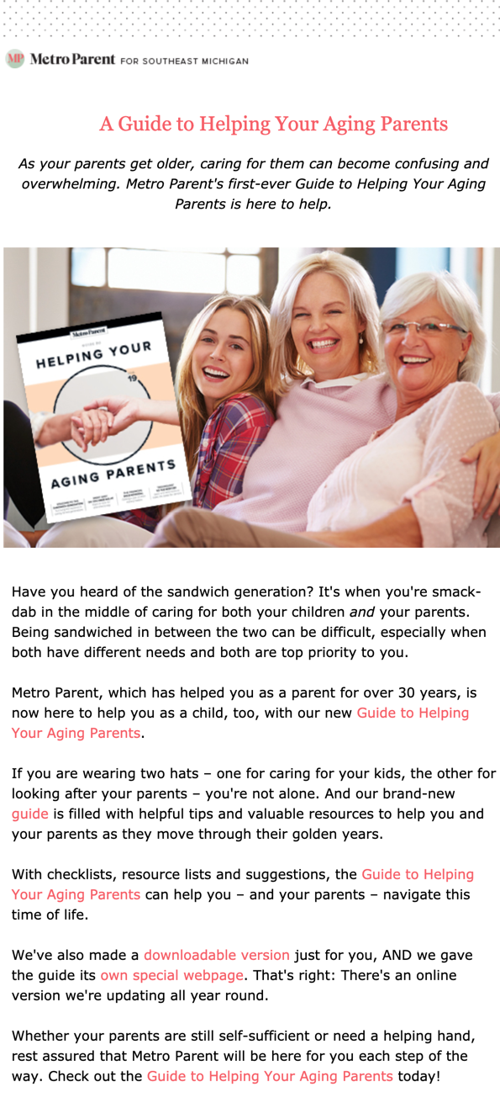
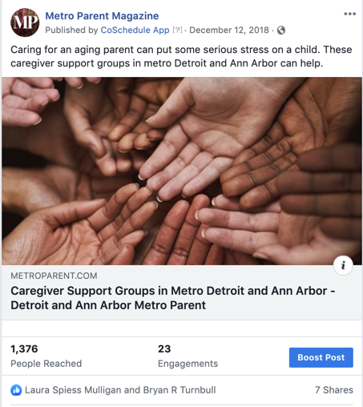
Email and social outreach
Publisher’s Spotlight:
25,000+ subscribers; open rate: 15.7%
20.5% of people who opened the email clicked to the digital guide: Readers are hungry for resources and answers
Facebook posts:
25,000+ reach, and stories and resources that continue to draw readers year-round

Slide 5
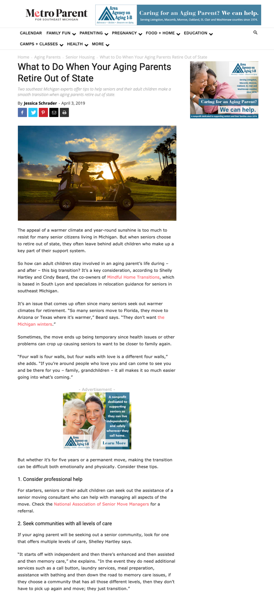
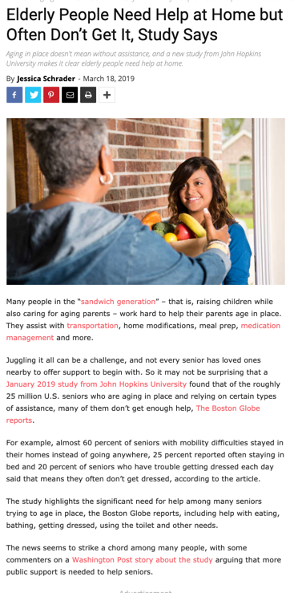
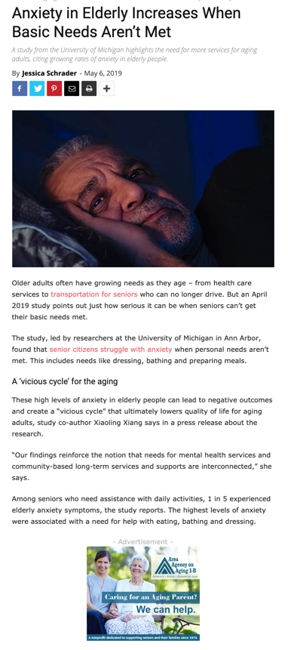
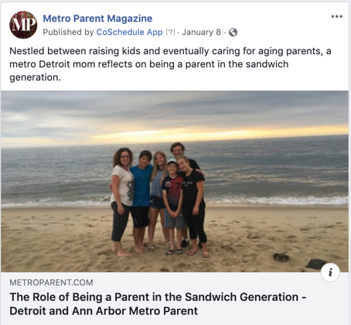
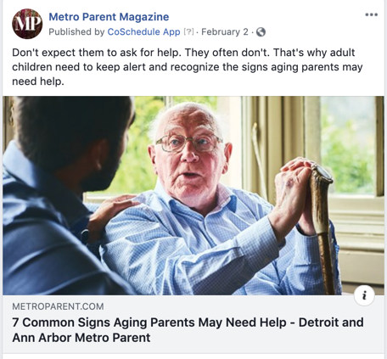
Stories since guide’s debut
The guide gets regular updates online, to stories, school listings and resources.
All stories are then posted to social media. Resource stories continue to gain momentum on Google.

Slide 6
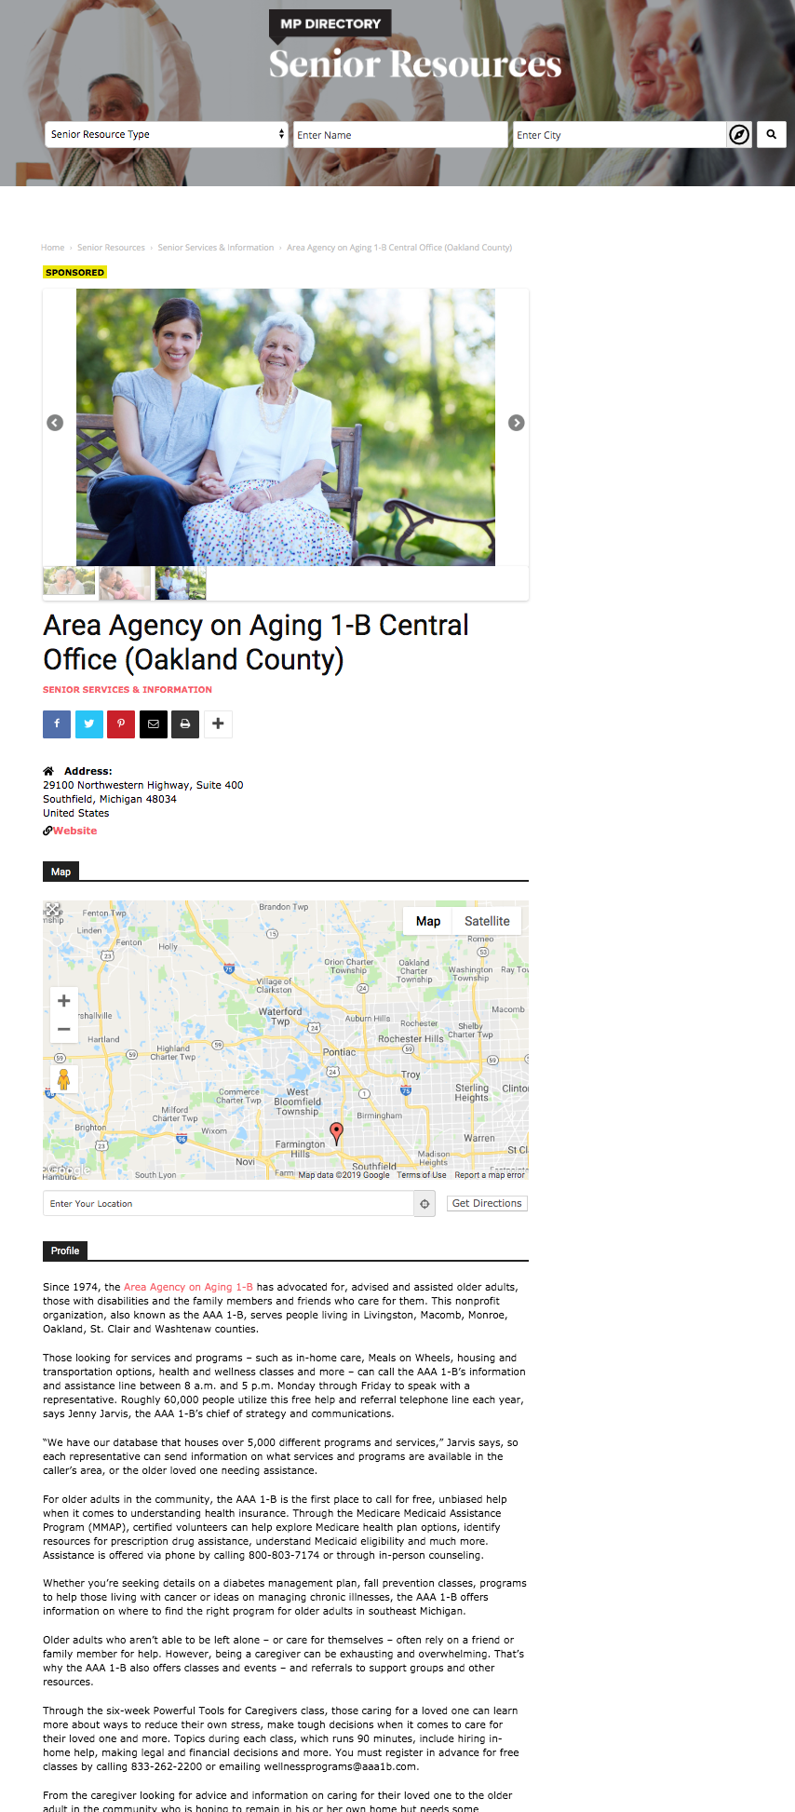
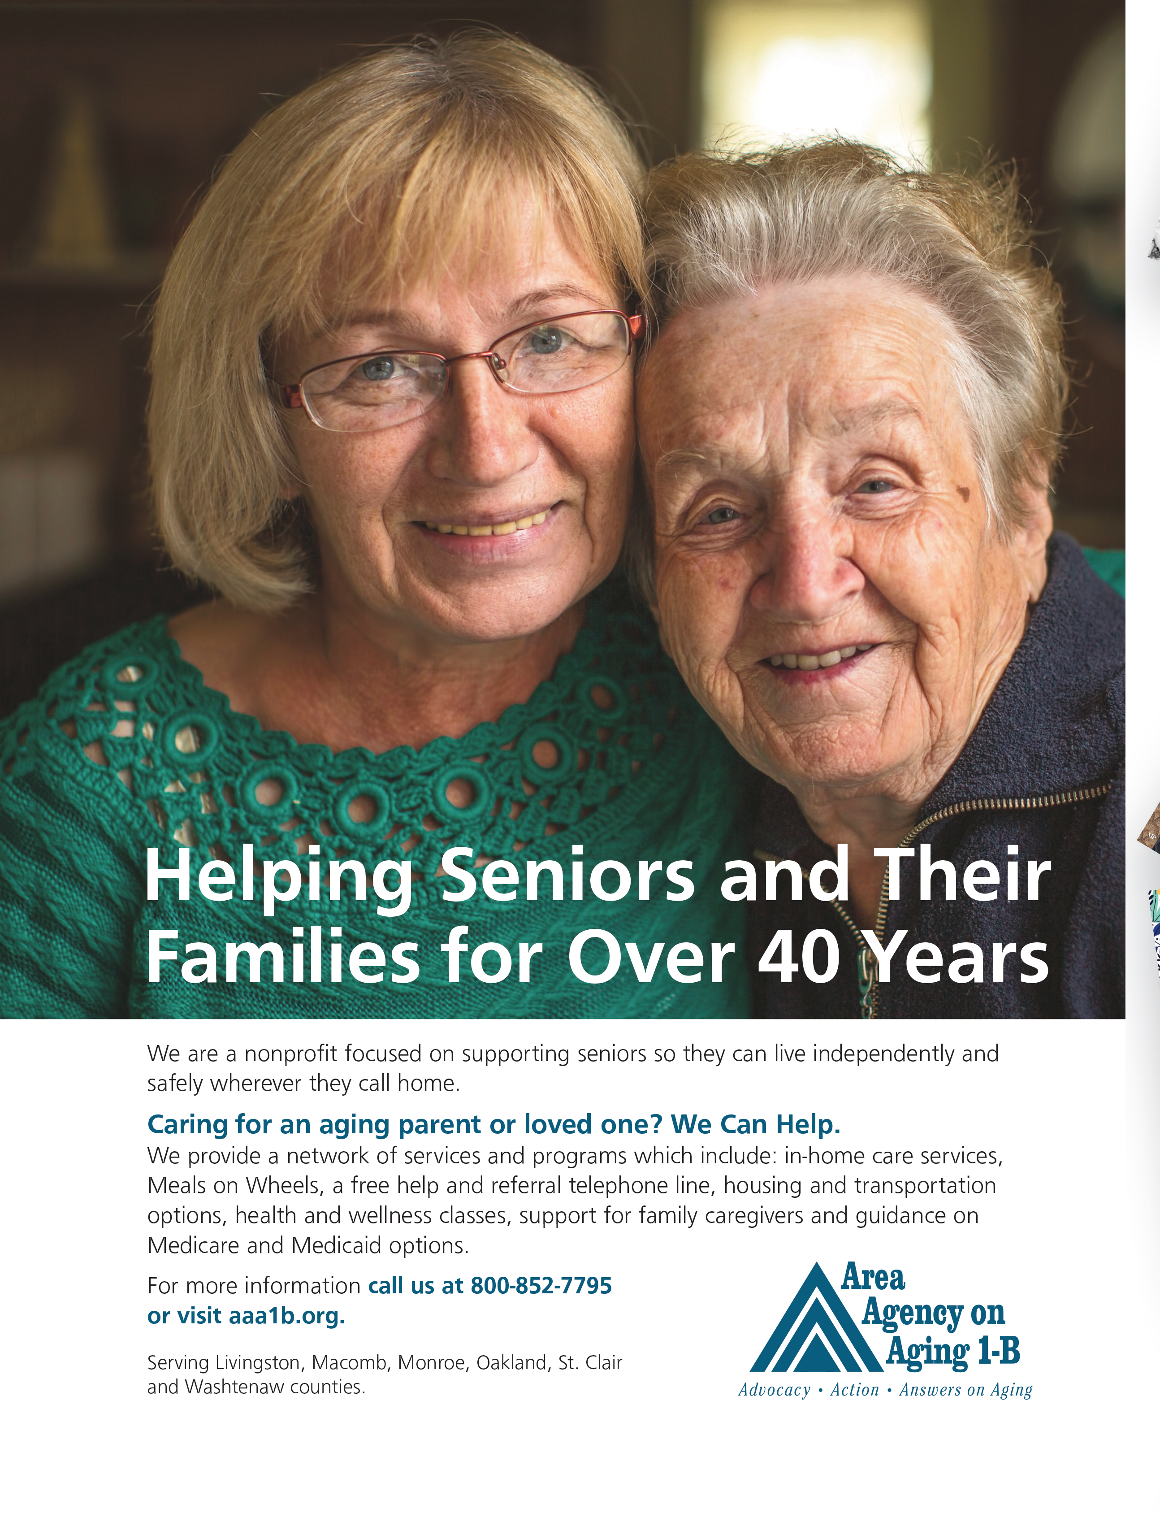
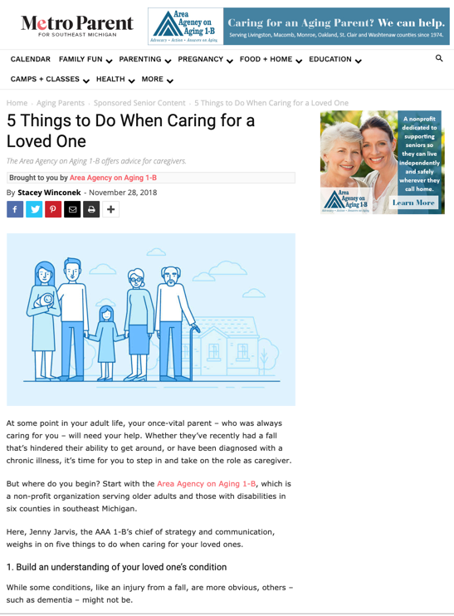
Sponsor content interwoven
Branded content fits seamlessly into the print section and online. Section sponsorship includes branding throughout the entire print section, and advertising roadblocks in the online section as well.

Slide 7
Value for Sponsors
Gold Sponsors
Value across all platforms, including:
Section sponsorship, branded content in print and digital
Featured profile in the online directory
Exclusive ads in print, digital; yearlong on MetroParent.com
Social media push for sponsored content
Silver Sponsors
Branded content in print, digital
Ads in print, digital
Featured profile in online directory
Bronze Sponsors
Ads in print, digital
Featured profile in online directory

Slide 8
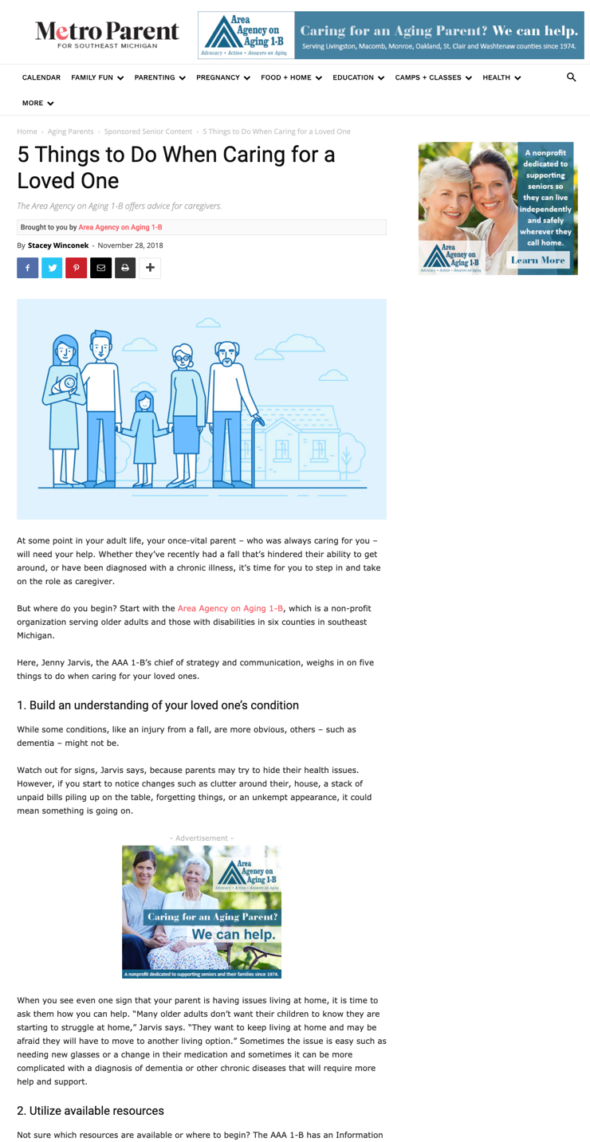
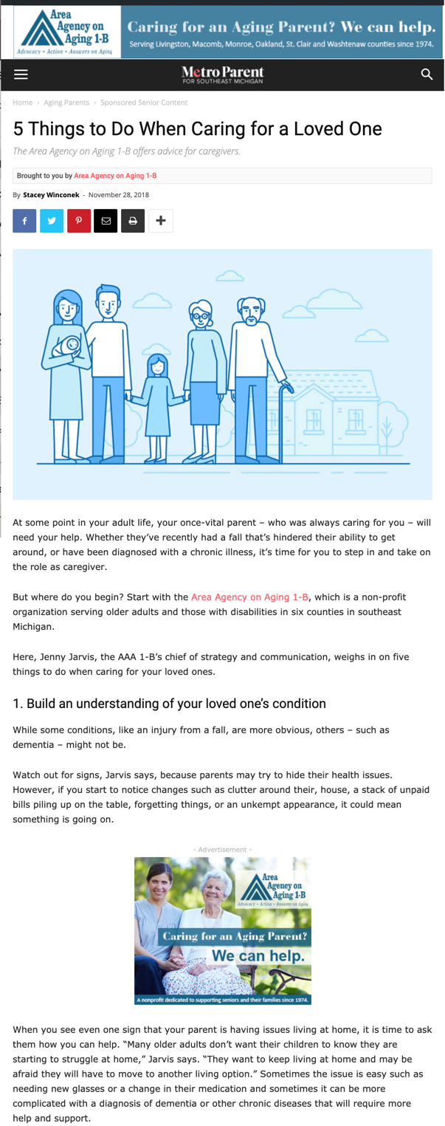
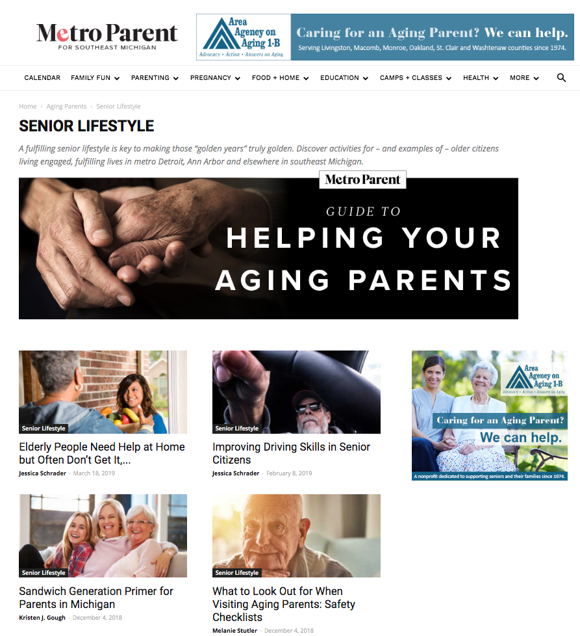
Gold Sponsors: Online ads
Gold sponsors receive more advertising real estate than any other advertiser throughout Aging Parent section online.
Section page on desktop
Mobile view
Desktop view

Slide 9
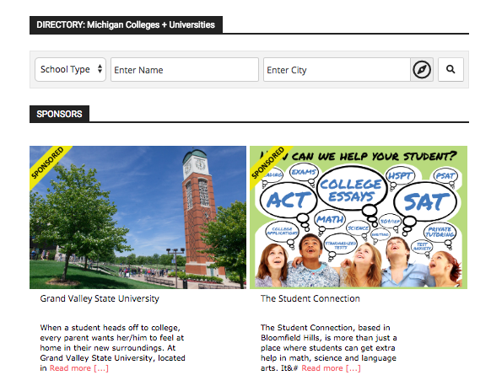
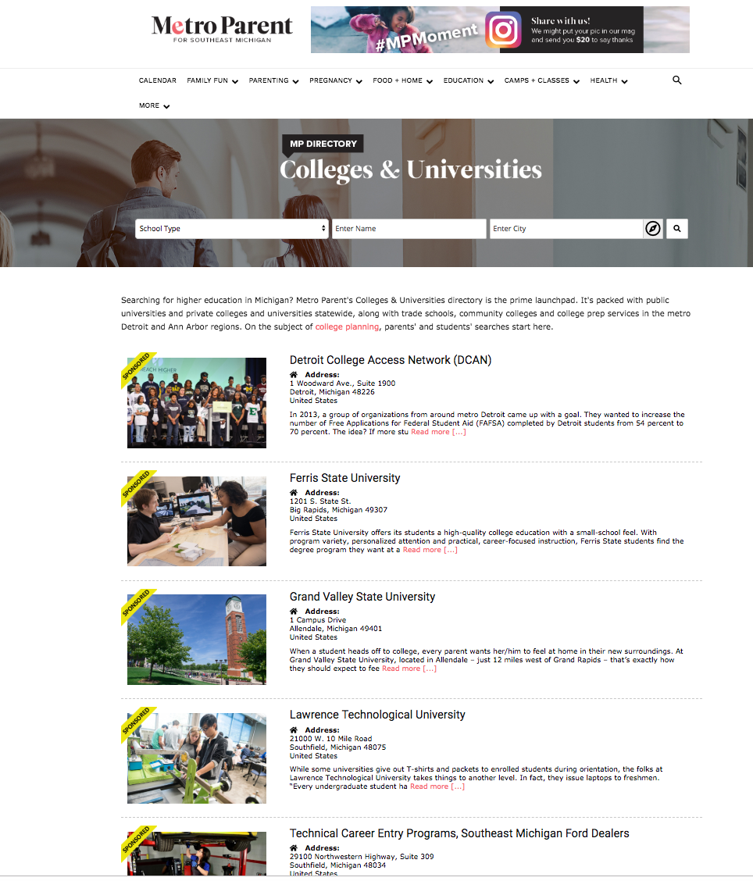
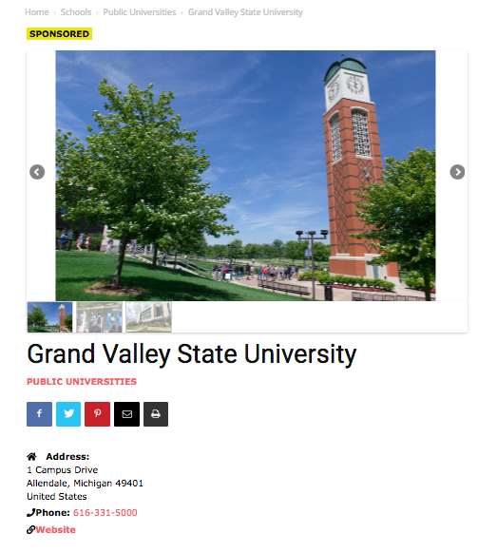
Gold Sponsors:
Featured schools
Featured schools and organizations receive premium placement in the Colleges and Universities directory, which is a part of every page in the Guide to College Planning.
There are 170 listings total. Searches surface the featured schools and resources first.
Featured schools are also part of a scrolling list of “sponsors” at the bottom of every page in the section.

Slide 10
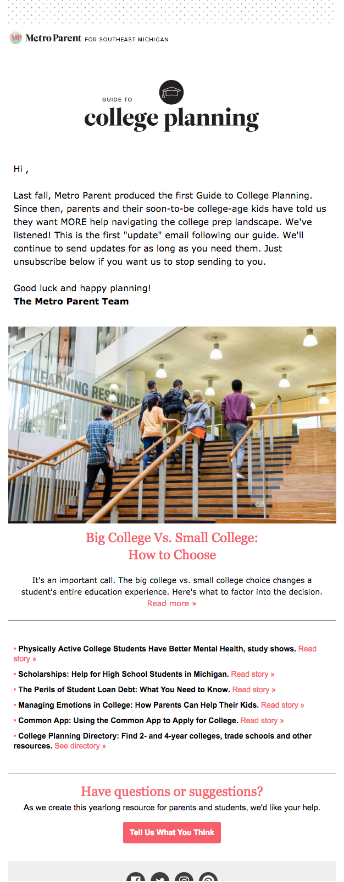
Year-round visibility
Because the Guide to College Planning was designed as a yearlong guide for parents and teens, it continues to build audience and SEO all year long.
Continuing through the rest of the year:
  Stories posted online at MetroParent.com
  Social media pushes on all platforms
  Audience extensions on search and social media platforms
  Email updates informing opted-in subscribers of new content.
  First email update: 51.7% total open rate
Expected year-round multiplatform audience: 150,000

