Slide 1
Nancy Hanus
Writing, editing, content strategy, audience development
PRINT, DIGITAL, SOCIAL

Slide 2
Cross-functional capabilities
Content Direction
Leadership of teams large and small
Personnel experience
Analytics acumen
Digital strategy
Audience segmentation and development
Project management
People skills
Experience working with sales, marketing, production, IT, events
Mentoring, teaching, coaching

Slide 3
Content: The key to excellence
Crain’s Detroit Business
Revamped digital operations, leading to a tripling of page views and unique visitors
Brought Chartbeat, weekly traffic reports and daily standup web meetings to newsroom
Implemented SocialFlow for managing social uploads – then used it to automate posts for major projects like 40 Under 40 and 20 in Their 20s. Created FB likes contest for 40s (with top person getting $1,000 to donate to their favorite charity).
Oversaw creation and implementation of morning newsletter – which became the top revenue-generator of all newsletters, and won AABJ award for best overall newsletter
Implemented digital strategy that involved ALL reporters and allowed them to take their beat expertise to the web
Oversaw several editorial interns who went on to distinguish themselves with full-time jobs at Metro Times, Jalopnik, Oakland Press and Esquire.

Slide 4
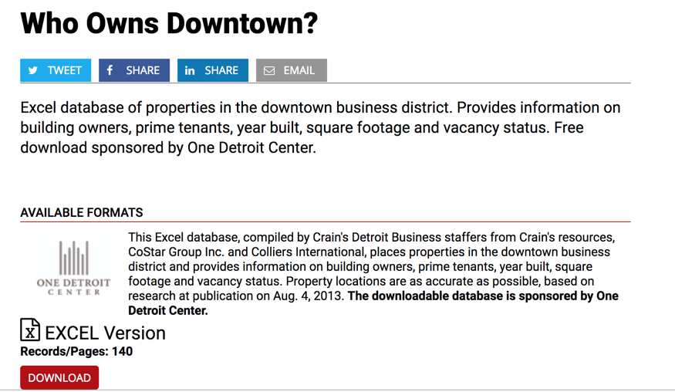
Revenue-generating products
Who Owns Downtown?
Downloadable spreadsheet of all buildings in downtown Detroit
Was created by editorial, pitched by sales to One Detroit Center
Sponsored downloads – sponsor got names of the 140 people who downloaded the spreadsheet for free

Slide 5
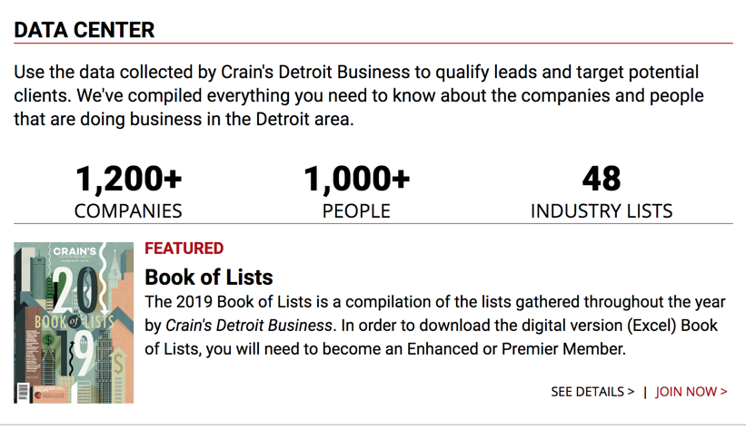
Revenue-generating projects
Created Data Center for both Detroit and Cleveland, then tied it into a Data Membership as we transformed from a subscription model to membership model.
Data Memberships: Sold 100 at $299 apiece in first 6 months live. (Subscriptions were $63 annual)
Got rid of sharply discounted “digital-only” subscription – valued digital at same price as print.

Slide 6
Membership model and data sub

Slide 7
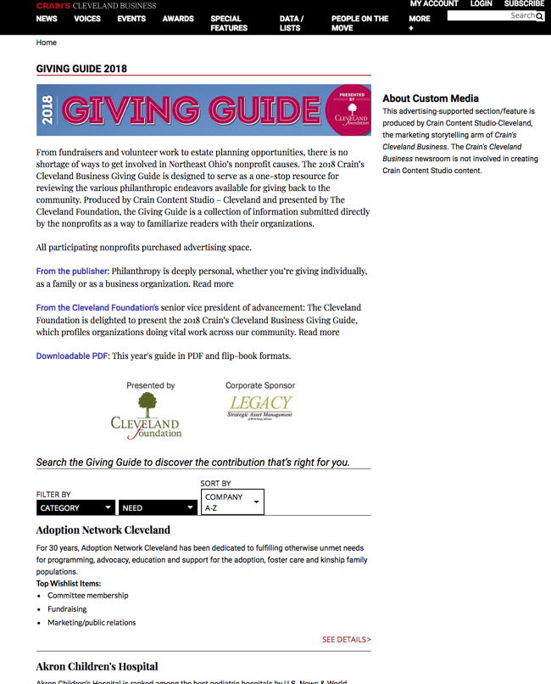
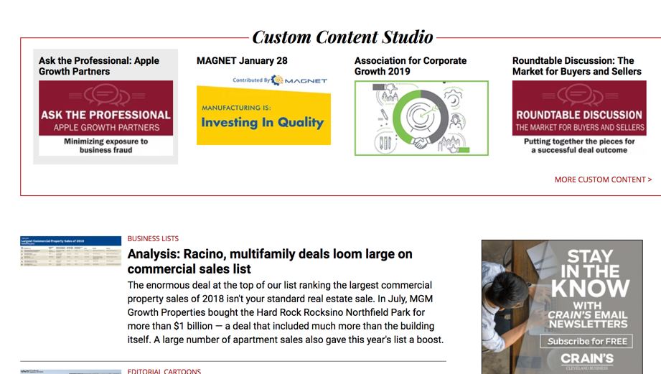
Sponsored (CUSTOM) CONTENT
Took all custom projects online for both Crain’s Detroit and Crain’s Cleveland; introduced home page custom module
Revamped Giving Guide digital for both books – making it an interactive database that allowed readers to contribute to nonprofits

Slide 8
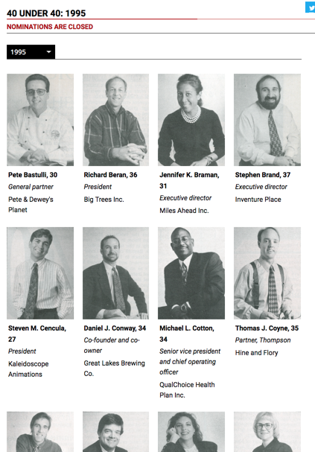
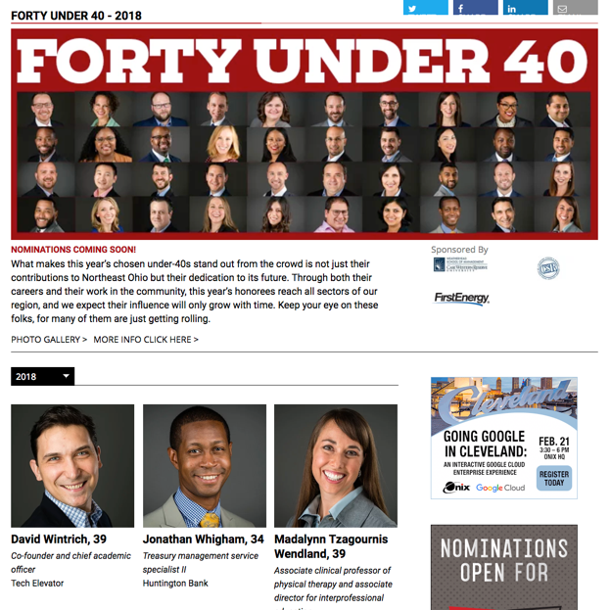
Project management
40 Under 40: Creating database for all 25 years – and creating an online link to allow past winners to update their profile data and have it tie into full database.
Did this for both Detroit and Cleveland – managing all profiles, pulled images, worked with engineers/developers to create template
Worked with sales teams on sponsors, and with editorial teams on writing “updated profiles” on past winners to draw attention and boost ticket sales

Slide 9
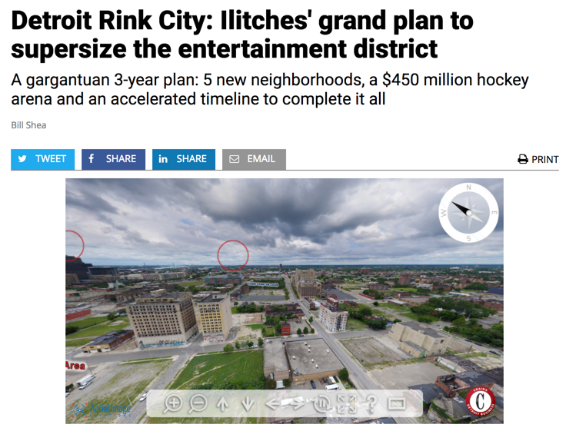
Detroit rink city: GOING BIG!!
Opportunity to “go big” with three-day advance on plans for Little Caesar Arena and district
We knew Freep had same information – and that we needed to do it better
Worked with LunaTech 3D to create interactive that included drone views
Won numerous awards – SPJ, AABJ – for digital

Slide 10
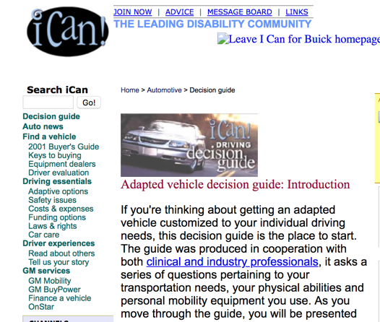
BUILDING A TEAM: iCAN.Com
ICAN.COM: 1999-2002
One of first 5 hires; took site online as editor and grew it to an editorial team of 40 channel content editors, writers and freelancers
Covered cross-country torch relay for 10th Anniversary of ADA, sending reporters to each city to cover live, in additional to doing all content in advance
Sent reporter to two Paralympic Games (Sydney and Salt Lake City) for one-man coverage of all events (30,000 words from Sydney alone)
Managed partnerships with AOL (primary disability news partner), General Motors (auto channel, $8M), Orbitz (travel channel)
Hired all editors and reporters over two years of company
Built out $8M auto channel with sponsorship by GM

Slide 11
Inheriting a team: DETNEWS.COM
As New Media Director at Detroit News, I managed team of 18, and integrated digital into full newsroom – every department managed their own bloggers, loaded content into CMS. Oversaw training of reporters/editors
Oversaw first major redesign of website – and it went on to win an EPpy Award for best designed website in United States (2008), for sites with traffic over 1M UVs/month
Oversaw implementation of photographer-driven photo galleries loaded on site from all events by photographers (a game-changer for sports).
Managed 40th anniversary of Detroit riots digital package, including video, slideshows and integration of reader stories; launched nationally recognized “Neighborhood Blog” out of the package

Slide 12
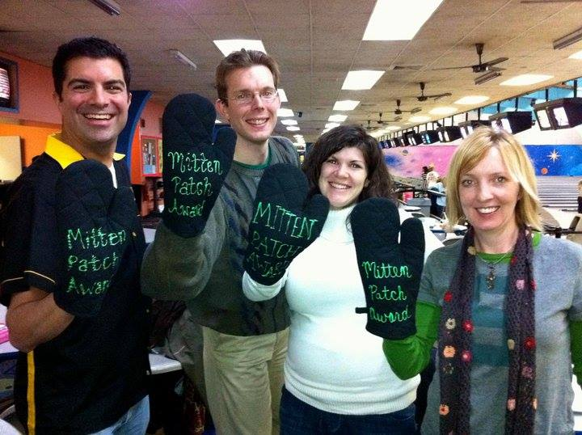
Mitten patcH: Michigan’s team
Worked with editors to launch 15 of the 29 Michigan Patches
Recruited and interviewed two other regional editors and a deputy RE
Managed largest of Michigan regions by traffic and audience
Worked with corporate on adding 24 potential communities to original list of 12

Slide 13
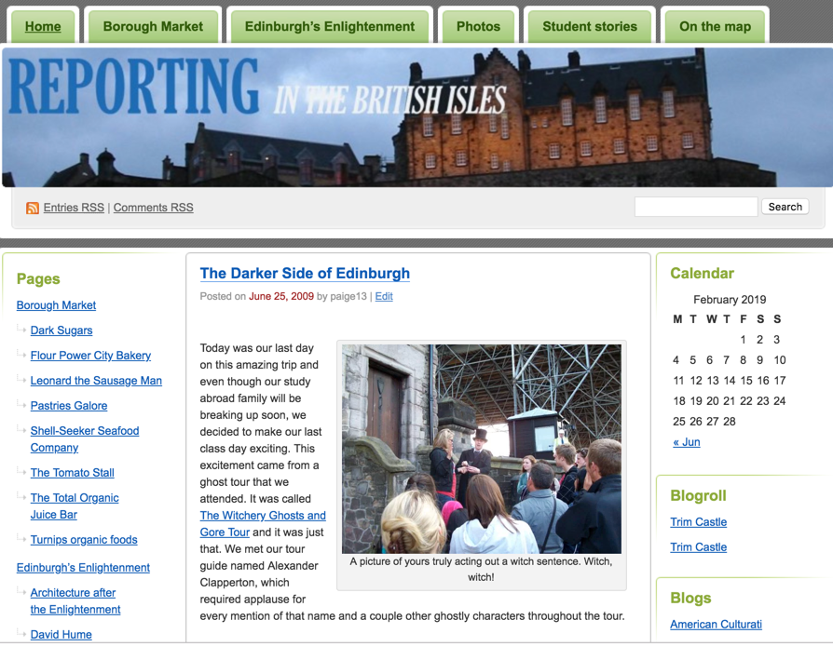
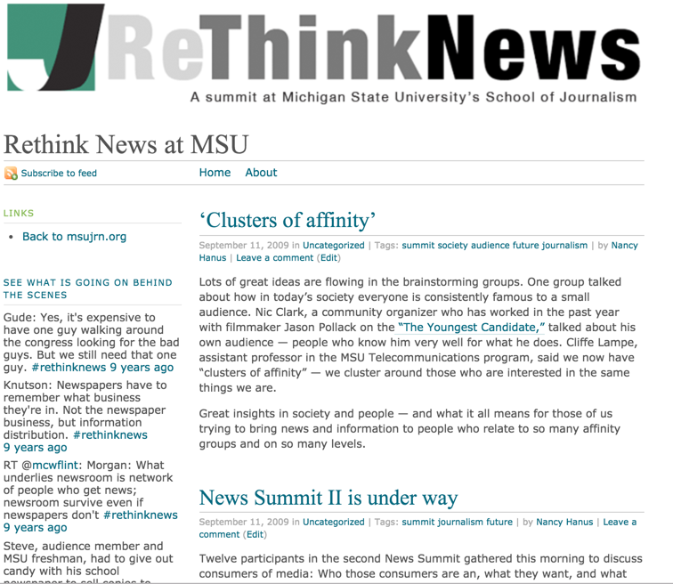
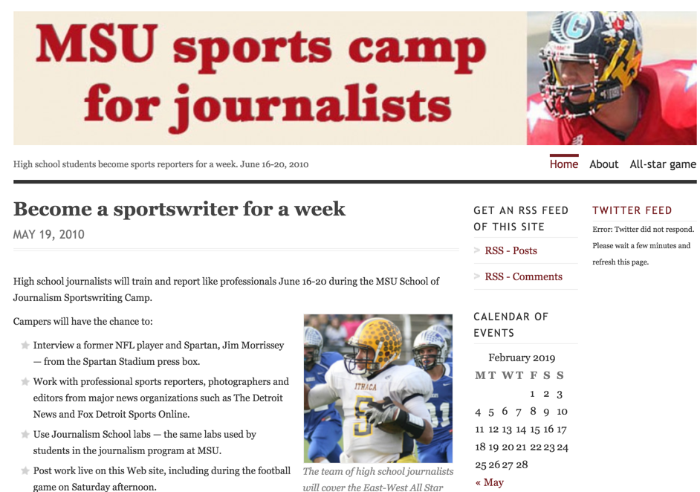
Teaching, mentoring, coaching
MSU School of Journalism: On faculty 2.5 years as visiting editor for new media. UM-Dearborn: Instructor 2018-2020.
On committee that revamped MSU J-School curriculum; created and taught first capstone online newsroom course
Planned and put on 2 Rethink News summits, pulling industry leaders and strategists from throughout state, and created website for summit.
Taught two study abroads in UK, recruiting students, creating curriculum, running program
Created and taught MSU Sportswriting Camp, created and taught digital tools to faculty

Slide 14
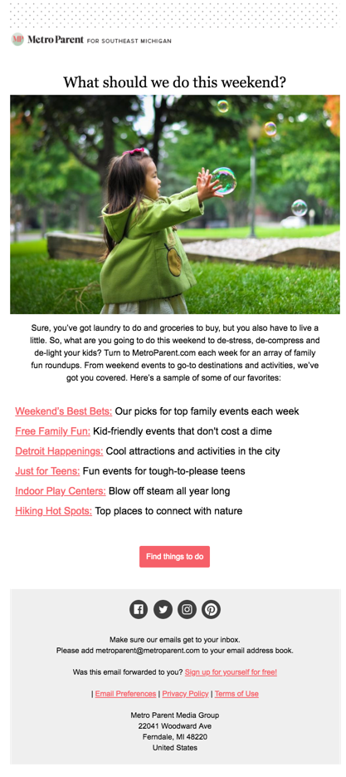
METRO PARENT MEDIA GROUP
Created Welcome and Re-Engagement journeys
Added Interest Tagging
Led creation of 2 ancillaries in digital form – something not done before
Led push for searchable/sortable directories in new ancillaries as blueprint for rest of site
In first month, led transition from many-year flat-doc approach to Mom-Approved Docs to database of profiles – increasing pageviews more than 200%

Slide 15
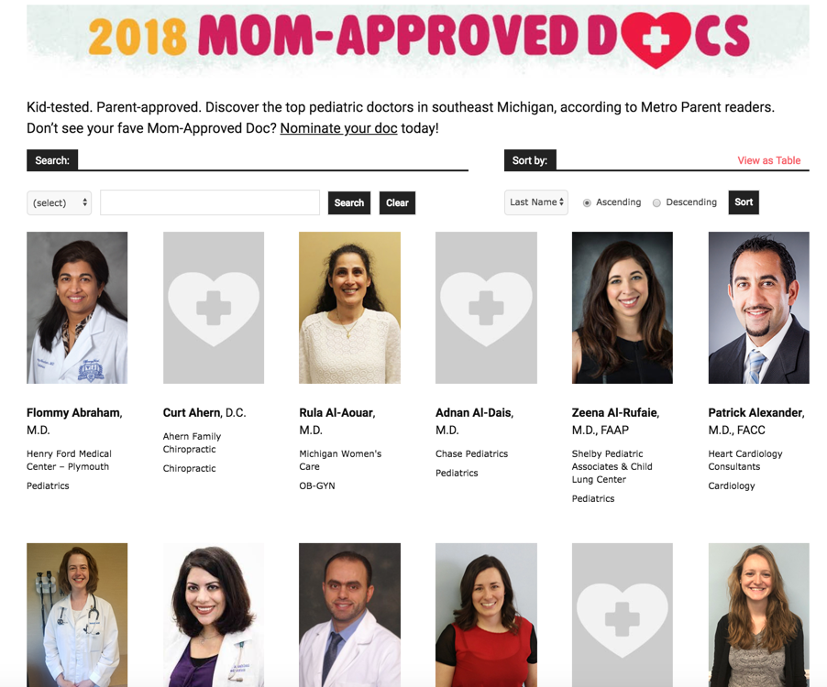
Mom-approved docs

